Slide 1
Notes:
Richard’s Abstract:
G10-Recurrence relations – a new pure topic in Further Maths -MEI - Richard Lissaman
The Fibonacci sequence is a well-known sequence defined in terms of a recurrence relation - subsequent terms are defined as a function of those already known. We’ll look at methods for solving various recurrence relations – i.e. finding terms as a function of their position in the sequence and some real world applications. This session will assume knowledge of recurrence relations from standard A level Mathematics.

Slide 2
Recurrence Relations – A new topic in Further Pure

Slide 3
An Example
Take a sheet of paper

Slide 4
An Example
Draw a straight line across it (anywhere you like) dividing it onto two regions

Slide 5
An Example
Repeat the process and you will have 4 regions

Slide 6
An Example
Keep repeating this process, each time trying to maximise the number of regions and record your answers.

Slide 7
An Example
Question: If you know the number of regions created by $n−1$ lines, how many regions will be created by $n$ lines?
Answer: As line $n$ crosses each of the existing $n−1$ lines it creates $n$ new regions, so: -
$$a_{n}=a_{n−1}+n$$

Slide 8
An Example
We can use this recurrence relation to work out a general formula for $a_{n}$ by repeatedly applying it, so: -
$$\begin{matrix}a_{n} & = & a_{n−1}+n \\ & = & a_{n−2}+\left(n−1\right)+n \\ & ⋮ & ⋮ \\ & = & a_{1}+2+3+…+\left(n−1\right)+n \\ & = & 2+2+3+…+\left(n−1\right)+n \\ & = & 1+\left(1+2+3+…+\left(n−1\right)+n\right) \\ & = & 1+\frac{1}{2}n\left(n+1\right) \end{matrix}$$

Slide 9
Recurrence Relations in A level
In Mathematics:
Numerical Methods (fixed point iteration and Newton-Raphson).
In Further Mathematics content differs by board but the main themes are:
Solving first and second order linear recurrence relations with constant coefficients;
Using induction to prove results about sequences and series;
Being able to apply knowledge of recurrence relations to modelling.
Notes:
AQA does not seem to mention recurrence relations in FM, all other specs do.

Slide 10
Numerical Methods

Slide 11
Fixed point iteration
Consider
${\frac{1}{4}x}^{2}+x−2=0$.
To carry out a fixed point iteration we need to first rearrange our equation into the form
$x=2−\frac{1}{4}x^{2}$.
To see this is an equivalent problem consider the following.

Slide 12
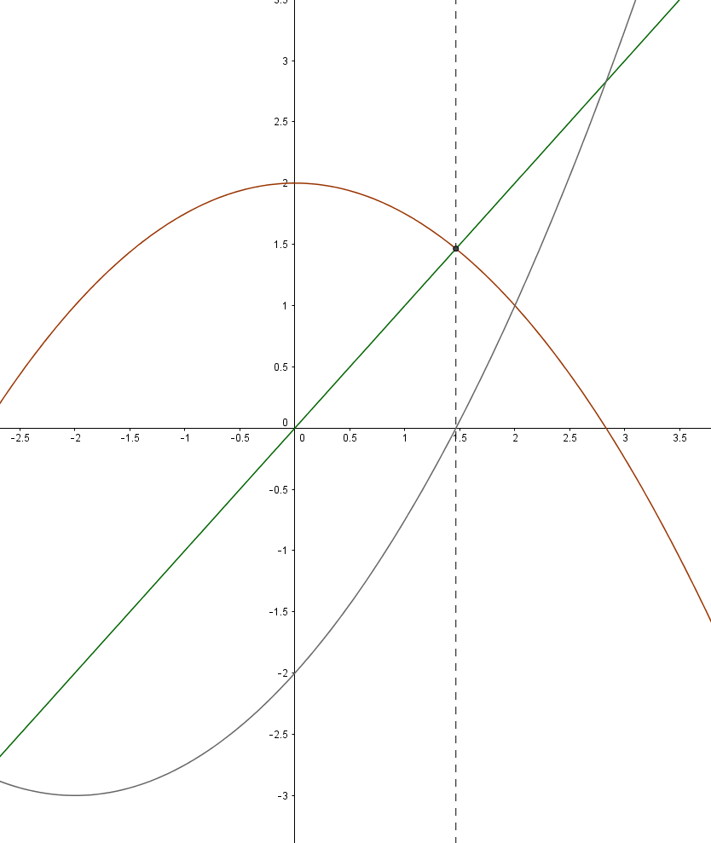
Fixed point iteration
$$y=x$$
$$y=2−\frac{1}{4}x^{2}$$
$$y={\frac{1}{4}x}^{2}+x−2$$

Slide 13
Fixed point iteration
So, to carry out a fixed point iteration re-arrange your equation into the form $x=g(x)$.
Starting with an initial value $x_{0}$ generate subsequent values of $x$ by using the recurrence relation $x_{r+1}=g(x_{r})$.

Slide 14
Fixed point iteration
$$x_{r+1}=2−\frac{1}{4}{x_{r}}^{2}$$
$$r$$ | $$x_{r}$$
$$0$$ | $$1$$
$$1$$ | $$1.75$$
$$2$$ | $$1.62$$
$$3$$ | $$1.55$$
… | …

Slide 15
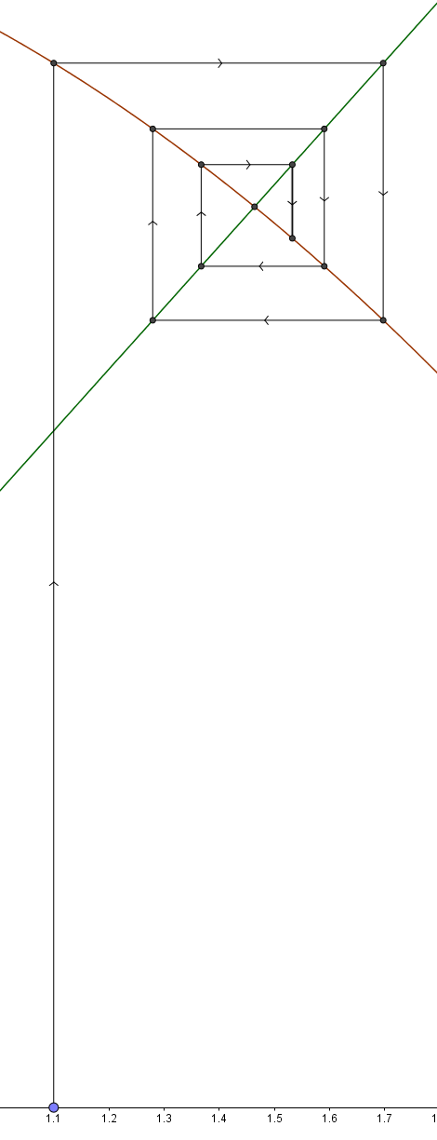
Fixed point iteration
$$y=x$$
$$y=2−\frac{1}{4}x^{2}$$

Slide 16
Fixed point iteration
Now consider $x^{3}−2x−1=0$.
First rearrange out equation into the form $x=\frac{x^{3}−1}{2}$.
This is equivalent to the original problem (as before).
We can explore what is happening in GeoGebra.

Slide 17
Fixed point iteration
However observe this time that if we pick an initial point close to the largest root our iteration is taking us away from the root rather than towards it, so is diverging in one case and converging to another root in the other.
So under what conditions can we use fixed point iteration?

Slide 18
Fixed point iteration
If $a$ is a fixed point of a function $g$ and the gradient of $g$ at $a$ is between $−1$ and $1$ and $x_{0}$ is sufficiently close to $a$ then the sequence generated by $x_{r+1}=g\left(x_{r}\right)$ will converge to $a$.

Slide 19
The Newton-Raphson Method
Consider again $x^{3}−2x−1=0$.
This method requires we pick an initial point and that we are able to calculate the derivative of our function.

Slide 20
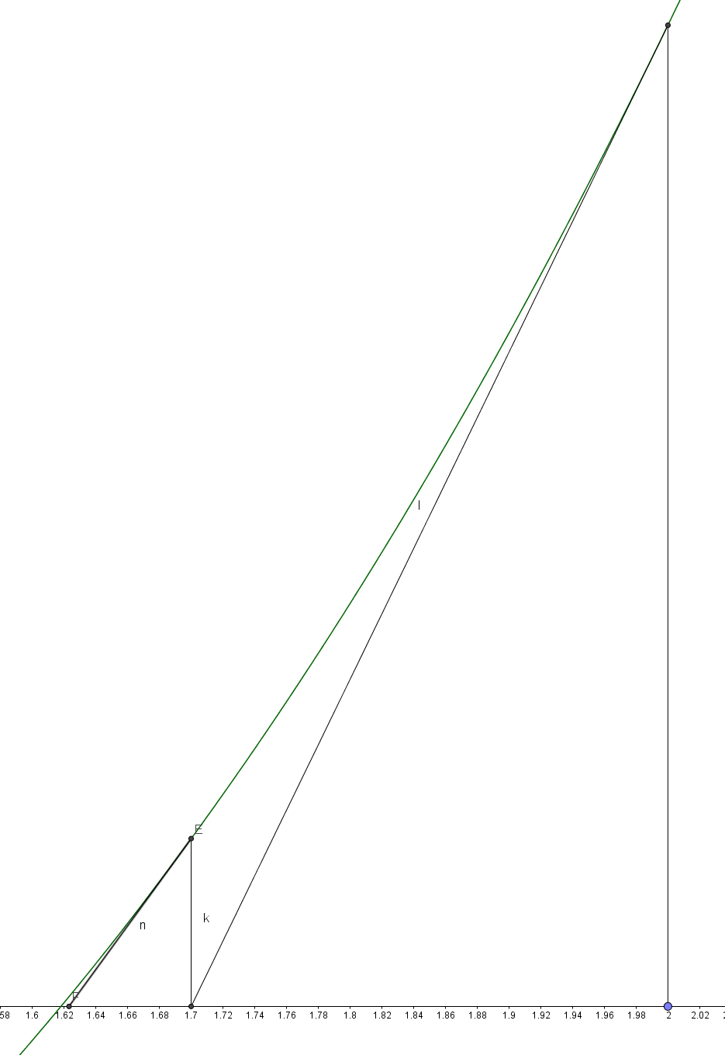
The Newton-Raphson Method
Given an initial point $x_{0}$ then next estimate $x_{1}$ given by the point where the tangent to $f\left(x_{0}\right)$ crosses the x-axis.
This process can then repeated as required.

Slide 21
The Newton-Raphson Method
$${f(x}_{0})$$
Gradient $f′(x_{0})$

Slide 22
The Newton-Raphson Method
So, if the tangent to $f(x)$ at $x_{0}$ is $y=mx+c$ then: -
$$m=f^{′}\left(x_{0}\right)$$
The equations of the line tangent to $f(x)$ at $x_{0}$ can therefore be written as: -
$y−f\left(x_{0}\right)=f′(x_{0})(x−x_{0})$.
So at $\left(0,c\right)$ we have$c=f\left(x_{0}\right)−f′(x_{0})x_{0}$.

Slide 23
The Newton-Raphson Method
Recall $m=f^{′}\left(x_{0}\right)$, and $c=f\left(x_{0}\right)−f′(x_{0})x_{0}$
Therefore the equation of the tangent to $f(x)$ at $x_{0}$ is: -
$$y=f^{′}\left(x_{0}\right)x+\left(f\left(x_{0}\right)−f^{′}\left(x_{0}\right)x_{0}\right)$$

Slide 24
The Newton-Raphson Method
Setting $x=x_{1}$ and $y=0$ in
$$y=f^{′}\left(x_{0}\right)x+\left(f\left(x_{0}\right)−f^{′}\left(x_{0}\right)x_{0}\right)$$
and rearranging we get
$$x_{1}=x_{0}−\frac{f\left(x_{0}\right)}{f′\left(x_{0}\right)}$$

Slide 25
The Newton-Raphson Method
In general
$$x_{r+1}=x_{r}−\frac{f\left(x_{r}\right)}{f′\left(x_{r}\right)}, f′(x_{r})≠0$$

Slide 26
Modelling using recurrence relations

Slide 27
Growth in a Bacteria Colony
A bacterial colony begins at hour zero with 20 individuals and then trebles in size every hour.
Write down a recurrence relation for $a_{n}$, the population at the beginning of hour $n$, and solve it.
How many hours elapse until the population exceeds ten million?

Slide 28
Growth in a Bacteria Colony
$a_{n}=3a_{n−1}$, where $n≥0$
We know that $a_{0}=20$, so: -
$$a_{n}=3a_{n−1}=3^{2}a_{n−2}=…=3^{n}a_{0}=20×3^{n}$$
So, $a_{n}=20×3^{n}$, $∀n≥0$.

Slide 29
Growth in a Bacteria Colony
How many hours until the population exceeds ten million?
$$20×3^{n}≥10,000,000⇔3^{n}≥\frac{10,000,000}{20}$$
So: -
$$3^{n}≥500,000⇔n≥\frac{\ln{500000}}{\ln{3}}≈11.94$$
Therefore we first reach 10 million bacteria at hour 12.

Slide 30
The Logistic Map
The logistic map, $x_{n+1}=rx_{n}\left(1−x_{n}\right)$ is a non-linear recurrence relation made famous by biologist Robert May in 1976 when modelling animal populations.
$x_{n}=\frac{\text{existing} \text{population}}{\text{maximum} \text{possible} \text{population}}$
As $r$ varies $\left(0≤r≤4\right)$ the model is intended to represent reproduction / starvation.
GeoGebra can be used to investigate changes in $r$.
Notes:
This is not in A level – I have just put in a single slide on it to show a real example of where recurrence relations have been used in modelling.

Slide 31
Second order recurrence relations – the Fibonacci numbers

Slide 32
Fibonacci’s Rabbits
First investigated by Fibonacci, c1200.
Assume you start at time 0 with no rabbits and at time 1 get a pair of rabbits (1 male, 1 female).
When a pair become 2 months old they give birth to another pair (1 male, 1 female).
Given the (unrealistic!) assumption that rabbits never die, how many pairs of rabbits do we have after $n$ months?

Slide 33
Fibonacci’s Rabbits
Let $f_{n}$ be the number of rabbits in month $n$.
By definition, $f_{0}=0$ and $f_{1}=1$. In subsequent months the number of pairs of rabbits will be given by the number from the previous month, $f_{n−1}$, plus the number of new rabbits, which is the same the number of rabbits at breeding age, i.e. $f_{n−2}$.
So: -
$$f_{n}=f_{n−1}+f_{n−2}$$

Slide 34
A Fibonacci Fact
To see another way the Fibonacci numbers are related to the Golden Ratio let: -
$$\lim_{n→∞}{\frac{f_{n+1}}{f_{n}}=L}$$

Slide 35
A Fibonacci Fact
Now, as $f_{n}=f_{n−1}+f_{n−2}$ we have: -
$$\begin{matrix}L = \lim_{n→∞}{\frac{f_{n+1}}{f_{n}}} & = & \lim_{n→∞}{\frac{f_{n}+f_{n−1}}{f_{n}}} \\ & & \\ & = & 1+\lim_{n→∞}{\frac{f_{n−1}}{f_{n}} } \\ & & \\ & = & 1+\frac{1}{L} \end{matrix}$$

Slide 36
A Fibonacci Fact
Wh have just shown that $L=1+\frac{1}{L}$.
So, $L^{2}−L−1=0$ and solving this quadratic gives:
$$L=\frac{1±\sqrt{5}}{2}.$$

Slide 37
Fibonacci Formula
The Fibonacci numbers have a general formula:
$$f_{n}=\frac{φ^{n}−Φ^{n}}{\sqrt{5}}$$
where
$φ=\frac{1+\sqrt{5}}{2}$ and $Φ=\frac{1−\sqrt{5}}{2}$

Slide 38
Fibonacci Formula
We will now prove this using induction
First, we need to check the two base cases, $n=0$ and $n=1$
$$f_{0}=\frac{φ^{0}−Φ^{0}}{\sqrt{5}}=\frac{1−1}{\sqrt{5}}=0$$
$$f_{1}=\frac{φ^{1}−Φ^{1}}{\sqrt{5}}=\frac{\frac{1+\sqrt{5}}{2}−\frac{1−\sqrt{5}}{2}}{\sqrt{5}}=\frac{\sqrt{5}}{\sqrt{5}}=1$$
Notes:
There is a proof involving matrices, eigenvalues and eigenvectors which may be of interest to some students…

Slide 39
Fibonacci Formula
Now, as $φ$ and $Φ$ are roots of $x^{2}−x−1=0$ we know that $φ^{2}=φ+1$ and $Φ^{2}=Φ+1$.
So if we assume the formula holds for previous values of $n$ we only need to verify the result holds for $f_{n}$ to complete the proof.

Slide 40
Fibonacci Formula
$$\begin{matrix}f_{n} & = & f_{n−1}+f_{n−2} \\ & & \\ & = & \frac{φ^{n−1}−Φ^{n−1}}{\sqrt{5}}+\frac{φ^{n−2}−Φ^{n−2}}{\sqrt{5}} \\ & & \\ & = & \frac{φ^{n−1}+φ^{n−2}−Φ^{n−1}−Φ^{n−2}}{\sqrt{5}} \\ & & \\ & = & \frac{φ^{n−2}\left(φ+1\right)−Φ^{n−1}\left(Φ+1\right)}{\sqrt{5}}\end{matrix}$$

Slide 41
Fibonacci Formula
$$\begin{matrix}f_{n} & = & \frac{φ^{n−2}\left(φ+1\right)−Φ^{n−1}\left(Φ+1\right)}{\sqrt{5}} \\ & & \\ & = & \frac{φ^{n−2}φ^{2}−Φ^{n−1}Φ^{2}}{\sqrt{5}} \\ & & \\ & = & \frac{φ^{n}−Φ^{n}}{\sqrt{5}} \end{matrix}$$
As required.

Slide 42
Fibonacci Formula
Another way to see this is by looking at the auxiliary equation of the recurrence relation (this is also know as the characteristic polynomial).
For those familiar with second order differential equations, the process here is very similar.

Slide 43
The Auxiliary Equation
In general for an order $d$ difference equation:
$$a_{n}={c_{1}a}_{n−1}+{c_{2}a}_{n−2}+…+{c_{d}a}_{n−d}$$
The auxiliary equation is:
$$p=x^{d}−c_{1}x^{d−1}−c_{2}x^{d−2}−…−c_{d}$$
If the roots, $r_{1},r_{2}, …,r_{n}$ are distinct the general solution has the form:
$$a_{n}=k_{1}r_{1}^{n}+k_{2}r_{2}^{n}+…+k_{d}r_{d}^{n}$$
Where $k_{i}$ are determined by the initial conditions.

Slide 44
Fibonacci Formula
So, as $f_{n}=f_{n−1}+f_{n−2}$ the auxiliary equation is $p=x^{2}−x−1$ whose roots are $φ$ and $Φ$.
Therefore the general solution has the form:
$$a_{n}=k_{1}φ^{n}+k_{2}Φ^{n}$$
To find $k_{1}$ and $k_{2}$ we need to substitute in $n=0$ and $n=1$.

Slide 45
Fibonacci Formula
From $a_{n}=k_{1}φ^{n}+k_{2}Φ^{n}$ we get:
$$a_{0}=0=k_{1}+k_{2}$$
Which give $k_{2}=−k_{1}$.
Also:
$$a_{1}=1=k_{1}φ+k_{2}Φ$$
Which gives $1=k_{1}φ−k_{1}Φ$.

Slide 46
Fibonacci Formula
Now, $1=k_{1}φ−k_{1}Φ$, so:
$\begin{matrix}1 & = & k_{1}\left(φ−Φ\right) \\ & = & \frac{k_{1}}{2}\left(1+\sqrt{5}−1+\sqrt{5}\right) \\ & = & \frac{k_{1}}{2}\left(2\sqrt{5}\right) \\ & = & \sqrt{5}k_{1} \end{matrix}$
So $k_{1}=\frac{1}{\sqrt{5}}$ and $k_{2}=−\frac{1}{\sqrt{5}}$ as required.

Slide 47
Repeated Roots
Earlier we said that if the roots, $r_{1},r_{2}, …,r_{n}$ are distinct the general solution has the form:
$$a_{n}=k_{1}r_{1}^{n}+k_{2}r_{2}^{n}+…+k_{d}r_{d}^{n}$$
If we have a polynomial with repeated roots, for example one which factorises as ${\left(x−r\right)}^{2}$ then:
$$a_{n}=k_{1}r_{1}^{n}+k_{2}nr_{2}^{n}$$

Slide 48
Another first order example:
The Towers of Hanoi

Slide 49
Towers of Hanoi
The Towers of Hanoi is a famous game invented by French mathematician, Édouard Lucas in 1883.
The game involves moving discs of decreasing size from the left most of three pillars to the right most, subject to the rules that we can only move one disc at a time and you cannot place a smaller disc on a larger one.
You can play the game in GeoGebra here.
Notes:
Lucas is also famous for studying Lucan sequences, which, roughly, are sequences satisfying a recurrence relation of the form
𝑎_𝑛=𝑝∙𝑎_(𝑛−1)+𝑞∙𝑎_(𝑛−2)
The Fibonacci numbers are a famous example.
As a backup, another online Towers of Hanoi game can be found at https://www.mathsisfun.com/games/towerofhanoi.html
People can easily play the game with coins they have with them

Slide 50
Towers of Hanoi

Slide 51
Towers of Hanoi
We can use the fact that $a_{n}=2a_{n−1}+1$ to obtain a general formula:
$$\begin{matrix}a_{n} & = & 2a_{n−1}+1 \\ & = & 2\left(2a_{n−2}+1\right)+1 \\ & = & 2\left(2\left(2a_{n−3}+1\right)+1\right)+1 \\ & & \\ & = & 2^{n−1}a_{1}+\sum_{i=0}^{n−2}{2^{i}} \\ & & \\ & = & \sum_{i=0}^{n−1}{2^{i}}=2^{n}−1 \end{matrix}$$

Slide 52
Towers of Hanoi
Alternatively, if we assume $a_{n−1}=2^{n−1}−1$ we can verify the general formula for the recurrence relation by induction: -
$$\begin{matrix}a_{n} & = & 2a_{n−1}+1 \\ & = & 2\left(2^{n−1}−1\right)+1 \\ & = & 2^{n}−2+1 \\ & = & 2^{n}−1 \end{matrix}$$

Slide 53
About MEI
Registered charity committed to improving mathematics education
Independent UK curriculum development body
We offer continuing professional development courses, provide specialist tuition for students and work with industry to enhance mathematical skills in the workplace
We also pioneer the development of innovative teaching and learning resources

Slide 54
MEI Conference
Three-day event for 14-19 mathematics teachers of all GCSE, Core Maths and A level specifications
29 June – 1 July 2017 at the University of Keele
4 workshop sessions every day, each with 8 choices
3 informative and entertaining plenaries
En-suite accommodation available
Register online at conference.mei.org.uk

