Slide 1

Who is it for?
What’s the content?
Why should you care?
What’s it like to teach?

Slide 2
Who is it for?
A-level
give up maths
resit GCSE
100 000
A*/A/B
250 000
A* - C
250 000
D or below
600 000
16-year olds do GCSE

Slide 3
What’s the content?
Up to 20 UCAS points
A/S Maths &
A2 Maths
Complex maths in straightforward settings
Core Maths
Straightforward maths in complex settings
GCSE
Straightforward maths in straightforward settings
(but those settings are getting harder!)
Level
3
Level
2

Slide 4
What’s the content?
2x 180 hours
180 hours in 2 yrs
A/S Maths &
A2 Maths
Complex maths in straightforward settings
Core Maths
Straightforward maths in complex settings
GCSE
Straightforward maths in straightforward settings
(but those settings are getting harder!)
Level
3
20%
Level 2½?
80%
Level
2

Slide 5

Straightforward maths in complex settings?
An A-level question
A Core Maths question
Use the substitution x = 2√2 sinθ to prove that
[7 marks]
(Edexcel A2 Mathematics)
Estimate the total number of school pupils in the UK.
State all your assumptions.
[5 marks]
(OCR Quantitative Reasoning )

Slide 6

Why should you care?
RECOMMENDATIONS:
Uptake (of post-16 maths) should be near universal within 10 years
All schools should be offering Core Maths within x* years
There should be no funding disincentives and there should be funding incentives to continue with Core Maths
* x would appear to be a number close to 5

Slide 7
So what’s it like to teach?
Depends which ‘it’ you mean

Slide 8
6 Different Qualifications

Slide 9







2016: 2931 entries
73%
6%
14%
6%

Slide 10
What’s in these courses?
Financial Maths:
Real rates from real banks
Exchange rates (real ones) commission and buy/sell rates)
Taxation (not Edexcel)
Critical Analysis
Do the figures support…?
Use the data to defend…
Why is the tax calculation wrong?
Modelling
(spreadsheets)
Statistics (Probability):
Stress interpretation (box-plots)
Concerned with the idea of ‘risk’
‘PROBLEM SOLVING’
Estimation:
practical approximation (inc bounds)
Fermi estimation (not Edexcel)

Slide 11
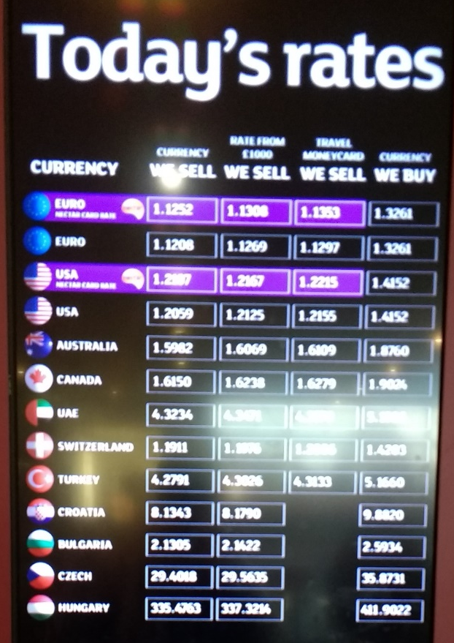
Money: a good place to start
Currency Exchange:
Mr McIvor wants to take 500 euros on holiday. He has £420 and is being offered an exchange rate of 1.13 to the £. Does he have enough?
Sainsbury’s Rates
Sell Buy
Euro 1.1252 1.3261
Mr McIvor plans to change his currency at Sainsbury’s. Estimate the commission rate.

Slide 12

Money: a good place to start
Sainsbury’s Rates
Sell Buy
Euro 1.1252 1.3261
Mr McIvor plans to change his currency at Sainsbury’s. Estimate the commission rate.
MODELLING
A SIMPLE APPROACH: Pick a sum of money (e.g £100)
convert to euros and back again
£ to € £100 × 1.1252 = €112.52
€ to £ €112.52 ÷ 1.3261 = £84.85
Over 15% charged across the 2 transactions so about 7.5% each way
Check with multipliers: 100 x 0.925² = £85.56

Slide 13
Money: a good place to start
but students need to be good with MULTIPLIERS
ANY METHOD YOU LIKE USING MULTIPLIERS
Calculate 15% of £25
Jack sees a book with an original price of £12 but marked 20% off. How much will jack save?
Jane is looking through the Argos catalogue. She sees a pair of earrings originally priced at £87.99 but marked 25% off. How much will she pay for the earrings?
Max buys a new car for £12000. Given that cars lose 15% of their value every year, how much will the car be worth after 3 years?
In a sale all prices are reduced by 30%. The sale price of a jacket is £70, what was the original price?
Olivia puts £1500 in savings account which pays 3% interest per year. How much will she have after 5 years?
An phnoe was reduced in price from £160 to £140.80. What is the percentage discount.
A diamond ring goes up in value from £4500 to £5940. What was the percentage increase
William got 32/70 on a test. What was his percentage?
‘All prices include VAT at 20%’. If a watch is priced at £29.99, what was the price before VAT was added?

Slide 14
Money: a good place to start
but students need to be good with MULTIPLIERS
ANY METHOD YOU LIKE USING MULTIPLIERS
Calculate 15% of £25
Jack sees a book with an original price of £12 but marked 20% off. How much will jack save?
Jane is looking through the Argos catalogue. She sees a pair of earrings originally priced at £87.99 but marked 25% off. How much will she pay for the earrings?
Max buys a new car for £12000. Given that cars lose 15% of their value every year, how much will the car be worth after 3 years?
In a sale all prices are reduced by 30%. The sale price of a jacket is £70, what was the original price?
Olivia puts £1500 in savings account which pays 3% interest per year. How much will she have after 5 years?
An phnoe was reduced in price from £160 to £140.80. What is the percentage discount.
A diamond ring goes up in value from £4500 to £5940. What was the percentage increase
William got 32/70 on a test. What was his percentage?
‘All prices include VAT at 20%’. If a watch is priced at £29.99, what was the price before VAT was added?

Slide 15
Percentages and Multipliers
Find a basic introduction for students here:
https://youtu.be/UqVWmNc_n9A

Slide 16
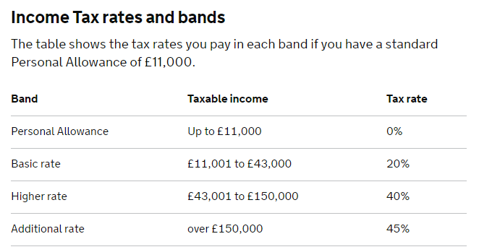
this is the amount you earn in ONE YEAR
usual abbreviation p.a. (per annum)

Slide 17

£20 000 pa
£11 001 - £43 000
Tax rate = 20%
20% of £20 000
= £4 000
✗

Slide 18
£20 000 pa
CALCULATION:
£20 000 - £11 000
= £9000 taxable income
0% of £11 000 = £0
20% of £9 000 = £ 1800
Income tax payable
= £ 1800
£ 20 000
£9 000
tax rate = 20%
£ 11 000
tax rate = 0%
£11 000
✓
£ 0

Slide 19
Introductory videos
Find the Income Tax lesson online here: https://youtu.be/jpgPsNVl2fA
Find the follow-up National Insurance lesson here: https://youtu.be/dCWDqzOB_28

Slide 20
Money: what next?
RPI/CPI and INFLATION are a new application of compound interest
SPREADSHEET MODELLING of savings plans with regular payments is a decent activity
INCOME TAX and NI are often popular
DON’T DO AER/APR TOO SOON

Slide 21
Fermi Estimation: it’s new!
BIG IDEA:
Getting rough answers for hard-to-calculate problems. Often work with orders of magnitude

Slide 22
How many pupils are there in the UK school system?
OCR Specimen Materials

Slide 23
How many 5-18 year olds are there in the UK?

Slide 24
Roughly how many people live in the UK?
A 100 000 B 1 000 000
C 10 000 000 D 100 000 000

Slide 25
Roughly how many people live in the UK?
A 100 000 B 1 000 000
C 10 000 000 D 100 000 000
Population of the UK roughly 100 000 000

Slide 26
What is the approximate lifespan in years of the average person in the UK?
A 1 B 10 C 100 D 1000
Average lifespan of people in the UK roughly 100
Population of the UK roughly 100 000 000

Slide 27
What is the approximate lifespan in years of the average person in the UK?
A 1 B 10 C 100 D 1000
Average lifespan of people in the UK roughly 100
Population of the UK roughly 100 000 000

Slide 28
What is the approximate lifespan in years of the average person in the UK?
A 1 B 10 C 100 D 1000
0 100
Population of the UK roughly 100 000 000

Slide 29
What is the approximate lifespan in years of the average person in the UK?
A 1 B 10 C 100 D 1000
0 100
0 100
million

Slide 30
Roughly how many 5 to 18 year olds are there in the UK?
A 10 000 B 100 000 C 1 000 000 D 10 000 000
0 100
0 100
million

Slide 31
Roughly how many 5 to 18 year olds are there in the UK?
A 10 000 B 100 000 C 1 000 000 D 10 000 000
0 10 20 30 40 50 60 70 80 90 100
0 10 20 30 40 50 60 70 80 90 100
million
Roughly 1 million people in every 1 year interval

Slide 32
Roughly how many 5 to 18 year olds are there in the UK?
A 10 000 B 100 000 C 1 000 000 D 10 000 000
0 10 20 30 40 50 60 70 80 90 100
5 18
13years
0 10 20 30 40 50 60 70 80 90 100
million
Roughly 1 million people in every 1 year interval

Slide 33
Roughly how many 5 to 18 year olds are there in the UK?
A 10 000 B 100 000 C 1 000 000 D 10 000 000
MODELLING AGAIN
0 10 20 30 40 50 60 70 80 90 100
5 18
13years
0 10 20 30 40 50 60 70 80 90 100
million
Roughly 1 million people in every 1 year interval
13 year interval corresponds to 13 000 000 people ≈ 10 000 000

Slide 34
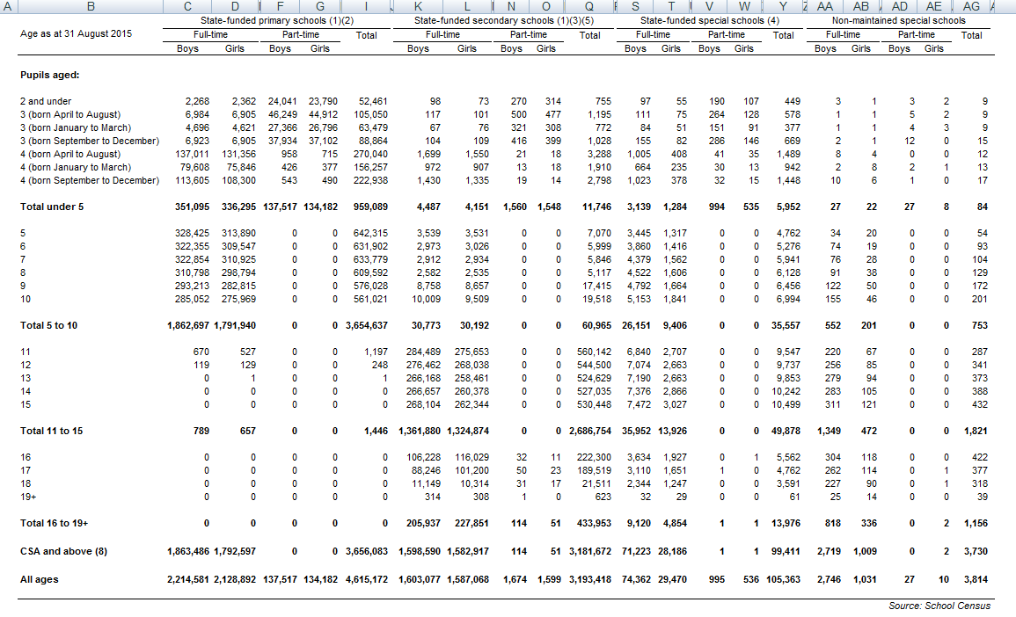

Slide 35
UK Government figure:
7 917 767

Slide 36
UK Government figure:
7 917 767
Fermi estimate:
10 000 000

Slide 37
Building Estimation skills
SINGLE STEP PROBLEMS
in a recent announcement the UK government said it will spend £5.2bn on £5.2 billion seems to be a huge amount of money; how much treatment will this buy you?
The New York Times reported that 30 billion tons of food is imported to the USA annually. Does this figure seem realistic?
MULTI-STEP PROBLEMS
A multi-billionaire offers to give you £5 billion but only if you count it out in £1 coins and arrange for them to be transported and stored at your home. Could you meet these conditions?
MORE INFO REQUIRED PROBLEMS
A newspaper suggests that 5% of the UK has a car parked on it. Is this figure reasonable?

Slide 38
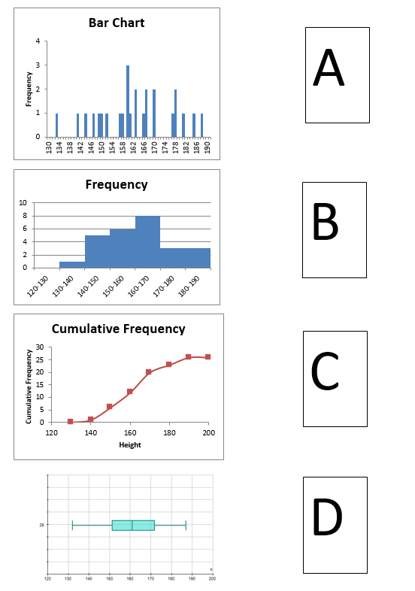
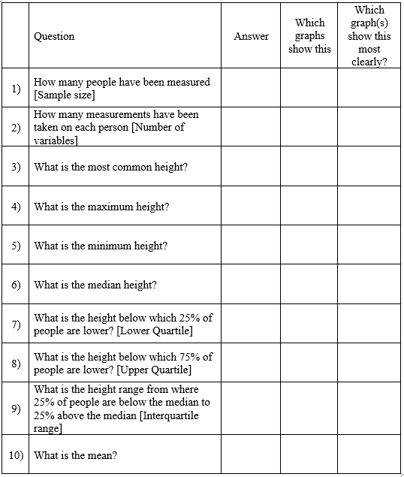
What about data?

Slide 39
Then what?
HOSPITAL DATA TASK (from OUP textbook)
For non-emergency treatment, the waiting time to see a consultant should be no more than 18 weeks from referral. The table gives the waiting time results for one hospital.
Comment on the hospital’s performance.
Use statistical measures and/or measures to support your comments (5)
Waiting time | % of patients
Less than 5 weeks | 2
5-9 weeks | 17
10-15 weeks | 26
16-17 weeks | 38
18 weeks | 12
19 weeks | 4
20 weeks | 1
More than 20 weeks | 0
95% of appointments were within 18 weeks so the hospital is doing well
1/5

Slide 40
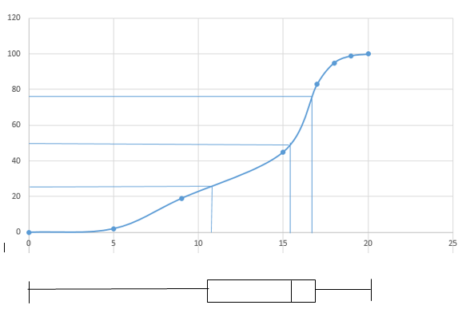
CRITICAL ANALYSIS
With a median wait time of around 16 weeks, the hospital appears to be struggling to meet its 18 week target. While it is encouraging to note that only 5% of the wait times are above the target, the half of patients have to wait 12-17 weeks, with only 25% experiencing a wait of under 11 weeks

Slide 41
And data beyond GCSE?
STANDARD DEVIATION is a good ‘higher level’ place to start (some good approaches for this)
CORRELATION looking formally at regression lines through a mean point and correlation coefficients is often quite successful (lots of opportunities for spreadsheets here)
THE NORMAL DISTRIBUTION IS HARD
AVOID CONFIDENCE INTERVALS UNTIL Y13

Slide 42


Topics to watch out for:
AER/APR
Annualisation causes enormous confusion – don’t tackle
it until the students are really good with multipliers.
The compound interest formula is probably the most
bewildering one they will see
THE NORMAL DISTRIBUTION
They need to be really fluent with this, don’t rush to z-numbers.
Start with some real data, put it in a histogram and work out the proportions of a population between particular values. Use the Normal Distribution as a practical way of modelling reality.

Slide 43
Things I wish I’d known before we started to teach Core Maths:
There’s plenty of time to get through the content so don’t rush, take the time to develop those higher level thinking skills
The students need to feel they’re learning something new so give them a quick win early on (Financial Maths is good)
When you assess them, build up to those hard, ‘10 mark questions’ slowly, use carefully constructed multiple choice and short questions at the start
Take the time to find at least one really good, interesting problem to work on each week – there’s a lot more out there now

Slide 44
A Problem Solving Approach
Teaching FOR problem solving
probably has to come before
Teaching THROUGH problem solving

Slide 45
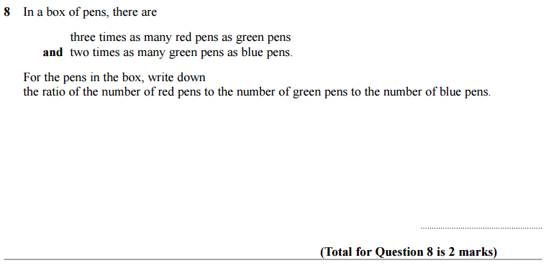
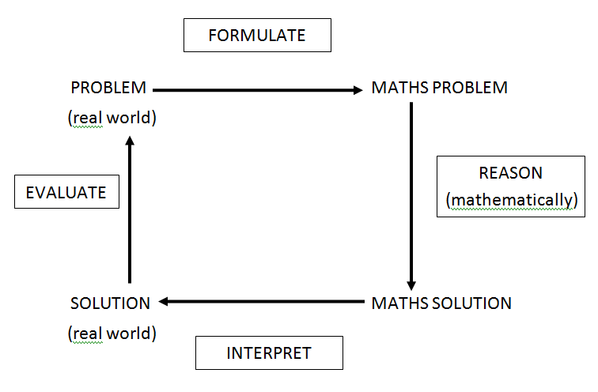
New questions from old

Slide 46
Draw a picture of what the box might contain

Slide 47
Stuff that has worked
Teaching FOR problem solving before teaching THROUGH it
Showing teachers how to scaffold through questioning
Showing teachers how to create new questions from old
TEACHERS
Have benefitted from experiencing a lesson then re-planning it straight afterwards
STUDENTS
Develop their critical thinking skills slowly

