Slide 1
A-level Mathematics/Further Mathematics
Introduction to the New Specification
Andrew Taylor
March 2017
Copyright © AQA and its licensors. All rights reserved.
Follow us on Twitter @AQACPD.

Slide 2
General approach
Structure
Assessment
Content (further maths only)
Resources and support

Slide 3
APPROACH

Slide 4
Background
Maths and Further Maths has not changed since 2004
The move to linear qualifications, announced in June 2012, meant that the subjects would need to be redeveloped
Students were entering Higher Education having taken many different routes and lacking skills in the use of technology
Number of different routes difficult to compare
A-Level Content Advisory Board (ALCAB) formed to decide content, common to all exam boards
Defined content for AS and A-level Maths and 50% for AS and A-level Further Maths
Slide 2
Copyright © AQA and its licensors. All rights reserved.
Follow us on Twitter @AQACPD.

Slide 5
Key changes
A-levels no longer modular
AS will be a stand-alone qualification
Redevelopment needed to better prepare students for higher education
Input from higher education throughout the process
Large data set in AS/A-level Maths
Prescribed content from the DfE for Maths and partly for Further Maths, confirmed in December 2014
The UCAS tariff has changed so that an AS is now worth approximately 40% of an A-level

Slide 6
Key features of the new Maths A-level generally
Key features
The content has been defined for us by the DfE – this is common across all exam boards.
The content for both AS and A-level splits approximately into two-thirds Pure content, one-sixth Mechanics content and one-sixth Statistics.
There is no Decision featured in this defined content.
The AS no longer contributes to the A-level, it is a separate qualification.
First exam for AS and A-level Maths will be summer 2018.
Slide 9
Copyright © AQA and its licensors. All rights reserved.

Slide 7
AQA’s philosophy
Top priority: Assessment that will encourage good teaching of mathematics
Applications with Pure Maths embedded
Holistic, non-modular approach to mathematics
Problem solving and modelling central
Targets
Clarity for teachers/ease of delivery in classrooms
Confidence building for students
Further Maths optionality - to suit needs of Higher Education, teacher preferences and sizes of centres - without loss of holistic approach
Strictly confidential

Slide 8
Key features of our development
We have chosen an assessment time of 3 hours for AS and 6 hours for
A-level.
Exams of no more than 2 hours
We have split the applications by sections in papers.
Question papers/sections ramp up in difficulty throughout
We have allowed calculators in all papers.
We have chosen multiple choice questions to ease the student in.
We have decreased the number of words used in our questions
Our papers look a little different – answer space now directly beneath the question

Slide 9
STRUCTURE

Slide 10
Our A-level Maths structure (Content 100% prescribed)
3 papers, 6 hours assessment time
Paper 1: Pure
2 hours
100 marks
Paper 2: Pure and Mechanics
2 hours
100 marks
(two sections of 50 marks)
Paper 3: Pure and Statistics
2 hours
100 marks
(two sections of 50 marks)
+
+
Assesses the following content only
(A) Proof
(B) Algebra and functions
(C) Coordinate Geometry
(D) Sequences and series
(E) Trigonometry
(F) Exponentials and logarithms
(G) Differentiation
Integration
Numerical Methods
May assess the following:
Any content from Paper 1
Will assess the following:
(J) Vectors
(P) Quantities and units in mechanics
(Q) Kinematics
Forces and Newton’s laws
Moments
May assess the following:
Any content from Paper 1
Will assess the following:
(K) Statistical sampling
(L) Data presentation and interpretation
(M) Probability
(N) Statistical distributions
(O) Statistical hypothesis testing
Strictly confidential

Slide 11
Our AS Maths structure
2 papers, 3 hours assessment time
Paper 1: Pure and Mechanics
1 hour 30 minutes
80 marks
(two unequal sections, Pure larger section)
Paper 2: Pure and Statistics
1 hour 30 minutes
80 marks
(two unequal sections, Pure larger section)
+
Assesses the following content only
(A) Proof
(B) Algebra and functions
(C) Coordinate Geometry
(D) Sequences and series
(E) Trigonometry
(F) Exponentials and logarithms
(G) Differentiation
Integration
(J) Vectors
(P) Quantities and units in mechanics
(Q) Kinematics
(R) Forces and Newton’s laws
Assesses the following content only
(A) Proof
(B) Algebra and functions
(C) Coordinate Geometry
(D) Sequences and series
(E) Trigonometry
(F) Exponentials and logarithms
(G) Differentiation
Integration
(K) Statistical sampling
(L) Data presentation and interpretation
(M) Probability
(N) Statistical distributions
Statistical hypothesis testing
Strictly confidential

Slide 12
Our A-level Further Maths structure
3 papers, 6 hours assessment time
Paper 3: Discrete and Statistics
2 hours
100 marks
(two sections of 50 marks)
or
Paper 1: Compulsory content
2 hours
100 marks
Paper 2: Compulsory content
2 hours
100 marks
Paper 3: Statistics and Mechanics
2 hours
100 marks
(two sections of 50 marks)
+
+
or
Paper 3: Mechanics and Discrete
2 hours
100 marks
(two sections of 50 marks)
Strictly confidential

Slide 13
Our AS Further Maths structure
2 papers, 3 hours assessment time
Paper 2: Discrete and Statistics
1 hour 30 minutes
80 marks
(two sections of 40 marks)
or
Paper 1: Compulsory content
1 hour 30 minutes
80 marks
Paper 2: Statistics and Mechanics
1 hour 30 minutes
80 marks
(two sections of 40 marks)
+
or
Paper 2: Mechanics and Discrete
1 hour 30 minutes
80 marks
(two sections of 40 marks)
Strictly confidential

Slide 14
ASSESSMENT

Slide 15
The structure of the papers
Papers with only one set of content, ie Pure papers
Features multiple choice questions at the start
Paper ramps up in difficulty throughout
Papers with mixed sets of content, ie Pure and Statistics
Each section will start with multiple choice
Each section will ramp up in difficulty
The applications have been split by section

Slide 16
Overarching themes from the DfE
Mathematical argument, language and proof
Mathematical problem solving
Mathematical modelling
The whole assessment is set within the context of the overarching themes.

Slide 17
Assessment Objectives
Assessment Objective | Weighting
 | AS Maths | A-level Maths | AS Further Maths | A-level Further Maths
AO1 Use and apply standard techniques | 60% | 50% | 60% | 50%
AO2 Reason, interpret and communicate mathematically | 20% | 25% | At least 10% | At least 15%
AO3 Solve problems within mathematics and in other contexts | 20% | 25% | At least 10% | At least 15%

Slide 18
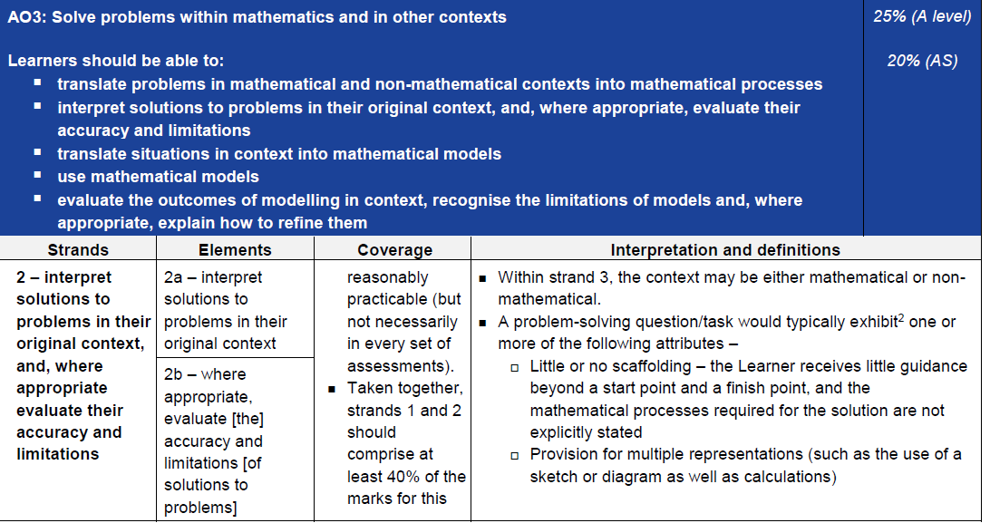
Assessment Objective 3

Slide 19
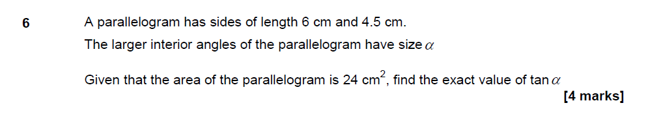
Problem solving – some examples

Slide 20
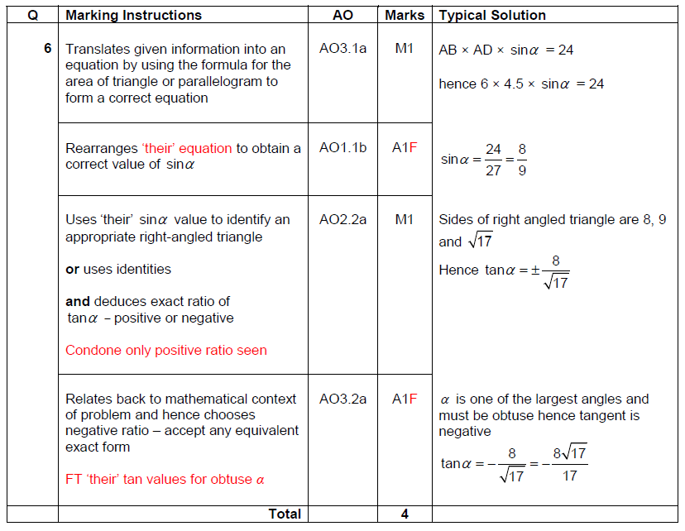

Slide 21
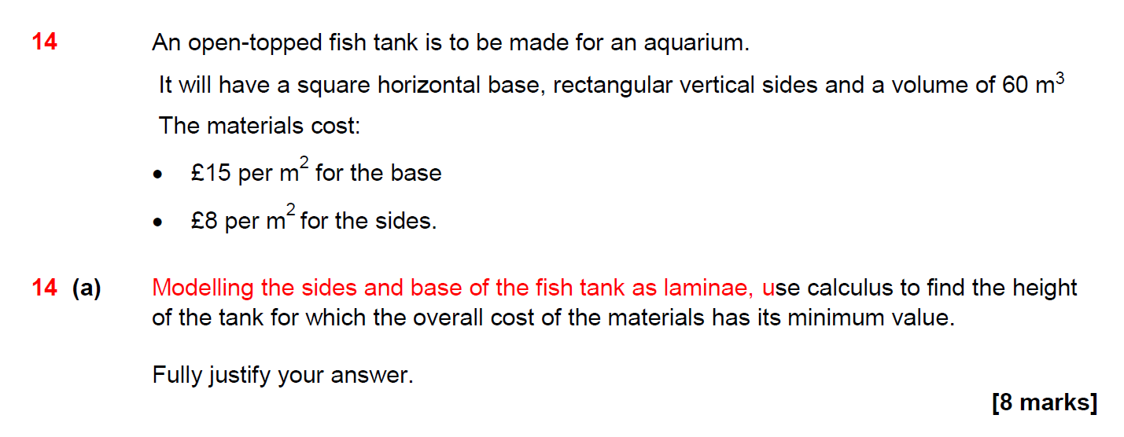

Slide 22
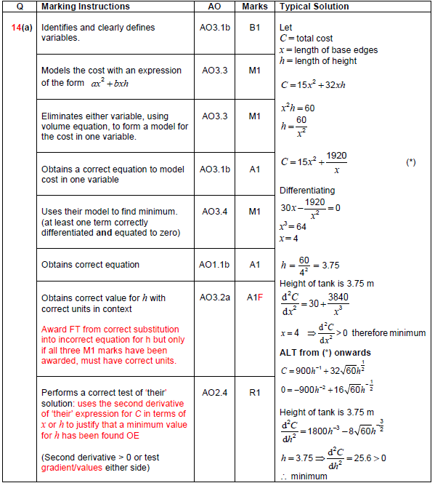

Slide 23
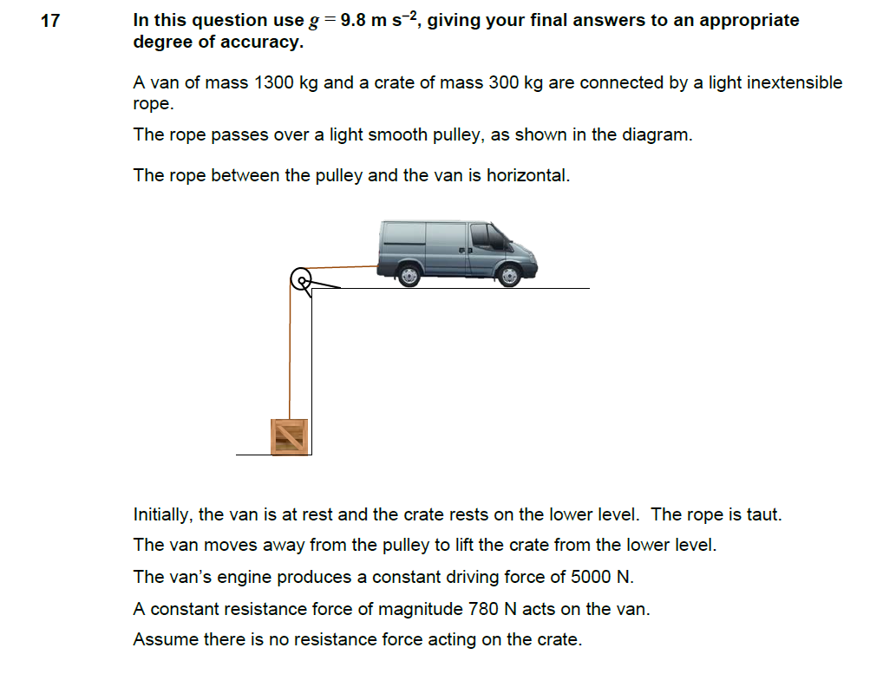

Slide 24
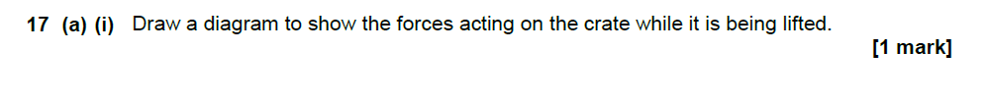
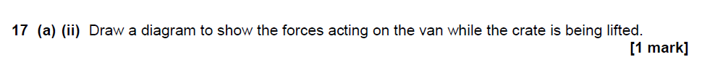
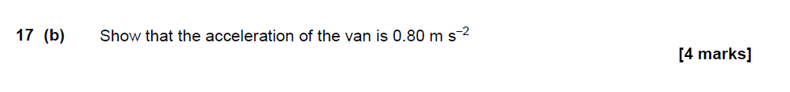
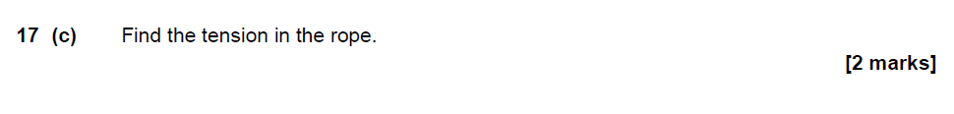
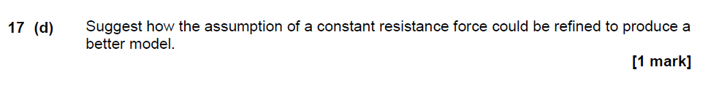

Slide 25
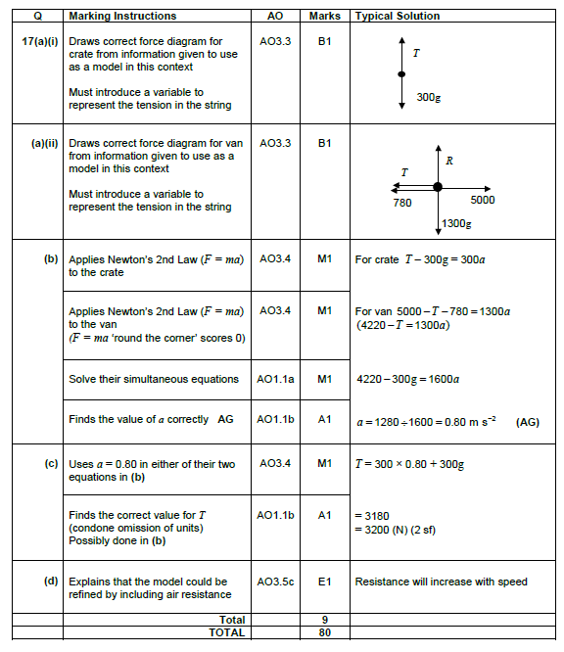

Slide 26
Use of large data in statistics
The use of one or more real ‘large data’ set
Chosen by each exam board
Used as a classroom tool including use of technology
Gets students familiar with working with and manipulating large sets of data
It is too large to be taken into the exam: suitable extracts may be used in a question
Exam boards are required to set questions that should be likely to give a material advantage to Learners who have studied, and are familiar with, the prescribed data set
Slide 11
Copyright © AQA and its licensors. All rights reserved.

Slide 27
Use of large data in statistics – Guidance from Ofqual
From the guidance document from Ofqual:
Our expectation is that these questions/tasks should be likely to give a material advantage to Learners who have studied, and are familiar with, the prescribed large data set(s). They might include questions/tasks which:
assume familiarity with the terminology and contexts of the data, and do not explain them in a way which provides Learners who have not studied the prescribed data set(s) the same opportunities to access marks as Learners who have studied them;
use summary statistics or selected data from, or statistical diagrams based on, the prescribed large data set(s) – these might be provided within the question/task, or as Stimulus Materials;
are based on samples related to the contexts in the prescribed large data set(s), where Learners’ work with the prescribed large data sets will help them understand the background context; and/or
require Learners to interpret data in ways which would be too demanding in an unfamiliar context
Slide 11
Copyright © AQA and its licensors. All rights reserved.

Slide 28

AQA are using…
Purchased quantities of household food
& drink by Government Office Region
and Country

Slide 29
Current status Maths
First submitted to Ofqual in June
First rejection received at the beginning of September
Ofqual reported no issues with our overall assessment structure
We are working with Ofqual on a number of changes, including:
- Assessment Objective and Overarching Theme allocations
- Mark scheme strengthening
Second rejection received in December
Still working on the Assessment Objective and Overarching Theme allocations
Ofqual are supportive of our new mark scheme structure
Re-submitted on 2 Feb
Accredited on 27 February

Slide 30
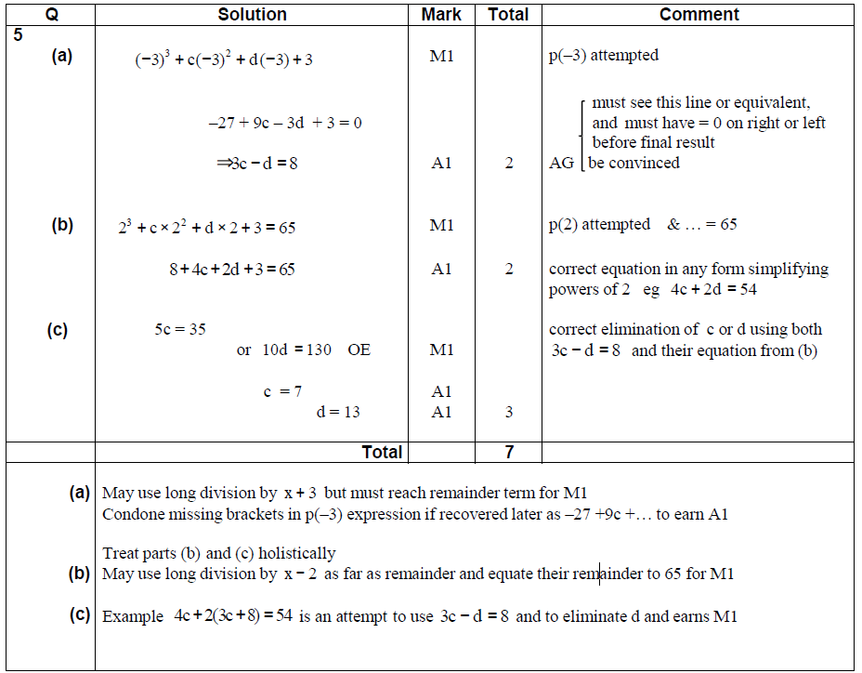
Current style mark schemes
Slide 23
Copyright © AQA and its licensors. All rights reserved.

Slide 31
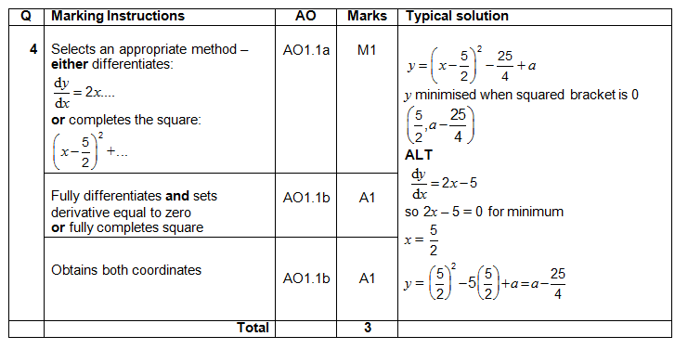
New style mark scheme
Slide 23
Copyright © AQA and its licensors. All rights reserved.

Slide 32
CONTENT

Slide 33
Further Maths – key features generally
Key features
50% of the A-level content has been defined for us by the DfE – this is common across all exam boards.
20% of the AS content has been defined for us by the DfE – exam boards had to choose a further 10% of the A-level content to put into the AS content
There is no Decision or Statistics featured in the defined content.
The remaining 50% has been carefully selected by us.
Slide 25
Copyright © AQA and its licensors. All rights reserved.

Slide 34
Our proposed 50% Further Maths content
With almost half of the content already prescribed that is pure for A-level, we decided to increase the pure content to make approximately two thirds. This will be compulsory content for all candidates.
Our final third will contain optional content from mathematical applications.
For AS we increased the pure content to half. This will be compulsory content for all candidates.
The other half will contain optional content from mathematical applications:
  Statistics
  Mechanics
  Discrete
Strictly confidential

Slide 35
Further maths content
Builds on compulsory (DfE) Content
  Further algebra and functions (section D)
  Further calculus (section E)
  Further matrices (section C)
Additional pure topics
  Trigonometry (section J)
  Numerical methods (section K)
  Coordinate geometry (section L)
Optional Applications (study 2 from 3 of)
  Mechanics (sections MA to ME)
  Statistics (sections SA to SG)
  Discrete (sections DA to DG)

Slide 36
Current status Further Maths
First submitted to Ofqual in June
Decision received at the beginning of September
Ofqual reported no issues with our overall assessment structure
We are working with Ofqual on a number of changes, including:
- Assessment Objective and Overarching Theme allocations
- Mark scheme strengthening
- Level of detail of content
Concentrating our efforts on getting Maths right first, resubmitted Further Maths in February.

Slide 37
SUPPORT & RESOURCES

Slide 38
Timeline
2016 | 2017 | 2018 | 2019
Submit to Ofqual in June | Free prepare to teach meetings spring/summer term | Summer series first exam for AS Maths and Further Maths | Summer series first exam for A-level Further Maths
Free launch meetings summer/ autumn term | First teaching of AS/A-level Maths and Further Maths | Summer series first exam for A-level Maths

Slide 39







Resources and support from AQA
Choosing the right qualification
Draft specification Draft question papers and mark schemes Specification at a glance Summary of changes
360°
SUPPORT
Results: reviewing and planning for improvement
Enhanced Results Analysis Teacher support feedback meetings Examiner reports Candidate exemplars with examiner commentary
Planning your course
Teacher support launch events Teacher support preparing to teach events Route maps
Assess: preparing for exams
Additional specimen question papers and mark schemes Topic Tests
Teaching your students
Resources linked to topics in the specification and throughout the teaching year (plan, teach, assess, results) Command words used in exams Publisher textbooks and digital resources Direct access to subject teams Teaching Guidance
Slide 39
Copyright © AQA and its licensors. All rights reserved.

Slide 40
Resources and support from AQA
2 sets of additional specimen question papers –
first set available after accreditation, second set available early 2018
Teaching guidance – available after accreditation (draft extract from
A-level Maths teaching guidance available on website now)
Route maps – available after accreditation
(draft AS Maths year 1, A-level Maths year 2 (power point version) available on website now)
Topic tests – available after accreditation
E-library – available after accreditation
Textbooks – available after accreditation
Slide 40
Copyright © AQA and its licensors. All rights reserved.

Slide 41
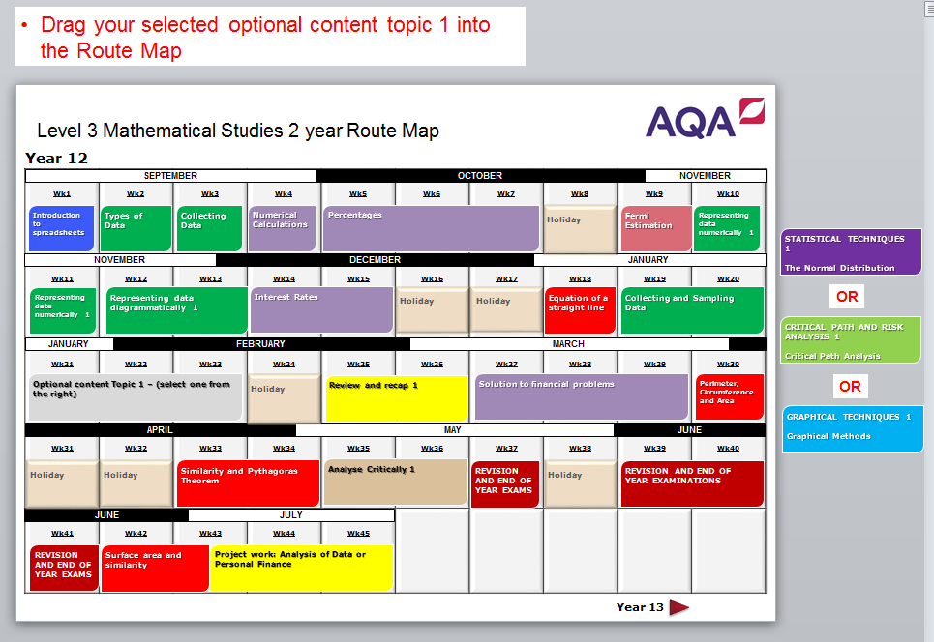
Resources and support from AQA
Slide 41
Copyright © AQA and its licensors. All rights reserved.

Slide 42
A DETAILED LOOK AT
PROBLEM SOLVING

Slide 43
New style Mark Schemes
AQA reformed A-level and AS in Maths and Further Maths have mark schemes that look quite different.
Rarely will any particular method be required in order to gain credit.
A high proportion of marks are designated as ‘Method marks’.
Where marks are awarded for accuracy, a high proportion of these marks allow ‘Follow Through’.
See Question 8 from A-level Maths paper 2

Slide 44
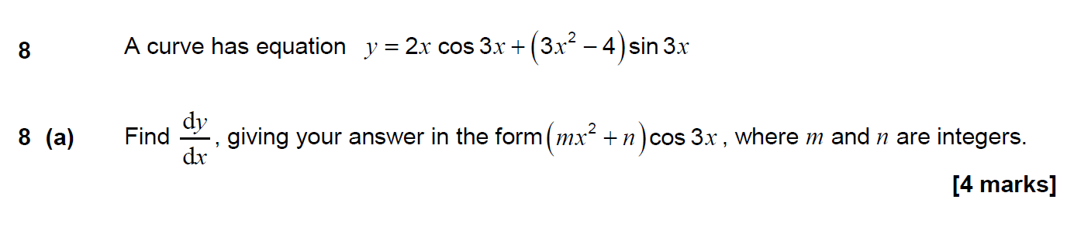
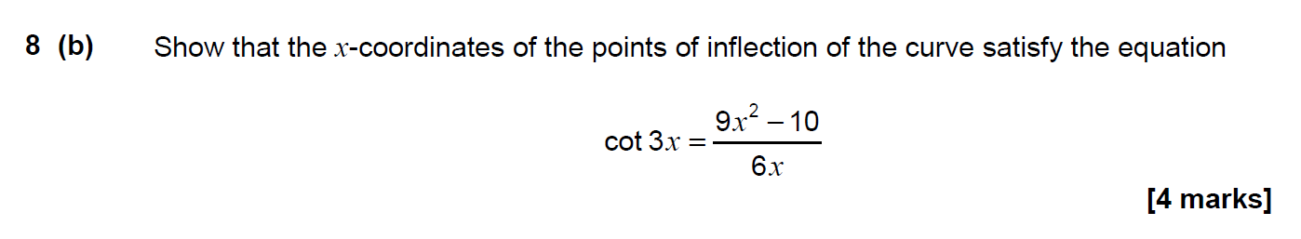

Slide 45
Overarching themes from the DfE
All questions within A-level/AS Mathematics and Further Mathematics must be set in the context of the overarching themes.
OT2 will be my focus today:
  Students should use their mathematical skills and techniques to solve challenging problems which require them to decide on the solution strategy and recognise when mathematics can be used to analyse and solve a problem in context.
Within OT2 we find the concept of a ‘Problem solving cycle’.

Slide 46
Problem solving cycle
Specifying the problem
Collecting information
Processing and representing information
Interpreting results
Repeating the cycle if necessary
Each set of assessment should include questions that require the use of multiple parts of this cycle
For example see Question 14 Maths A-level paper 1

Slide 47
Some Attributes of Problem solving questions
It is not necessary for every problem solving task to exhibit all of the following attributes.
At least one attribute should apply for a task to be regarded as problem solving.

Slide 48
Attributes of Problem solving questions
1. Little or no scaffolding…
little guidance will be provided beyond a start and end point
mathematical processes required are not explicitly stated
For examples see Question 11 AS Maths paper 1 and
Question 6 A-level Maths paper 3

Slide 49
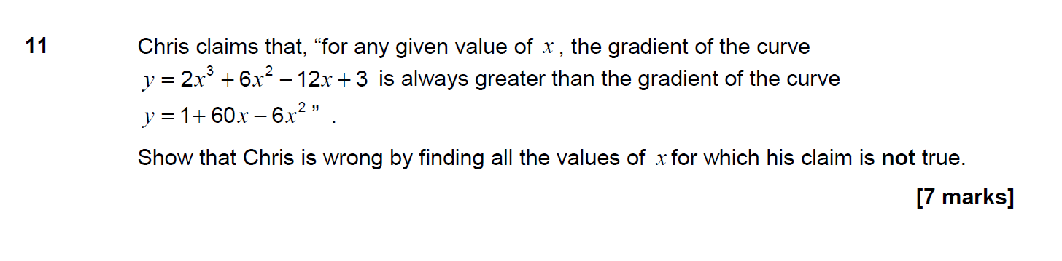

Slide 50
Attributes of Problem solving questions
6. Two or more processes are required, or the solution requires drawing together different parts of mathematics
For example see Question 11 AS Maths paper 1

Slide 51
Attributes of Problem solving questions
2. Provision for multiple representations
such as use of diagram as well as calculations
For example see Question 15 Maths A-level paper 3

Slide 52
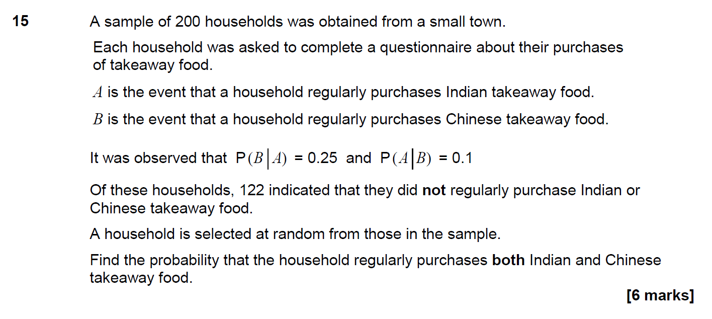

Slide 53
Attributes of Problem solving questions
3. Results and/or methods need to be interpreted and/or evaluated
for example in a real world context
For example see Question 15 Maths A-level paper 1

Slide 54
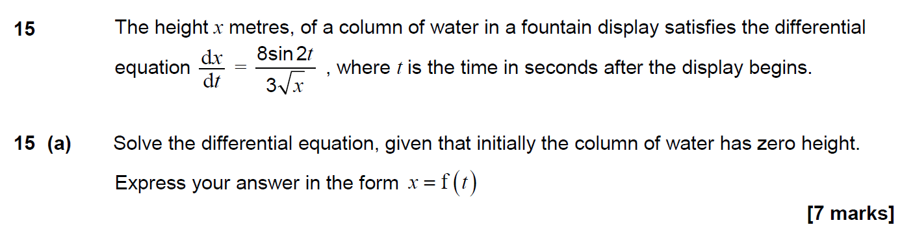
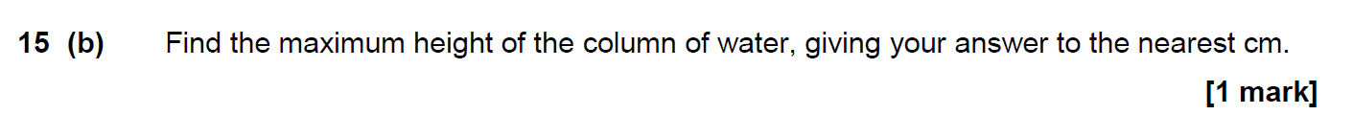

Slide 55
Attributes of Problem solving questions
4. A choice for the candidate of techniques to be used to solve the problem
For examples see Question16 (b) (ii) A-level Maths paper 2 and
Question 7 AS Maths paper 2

Slide 56
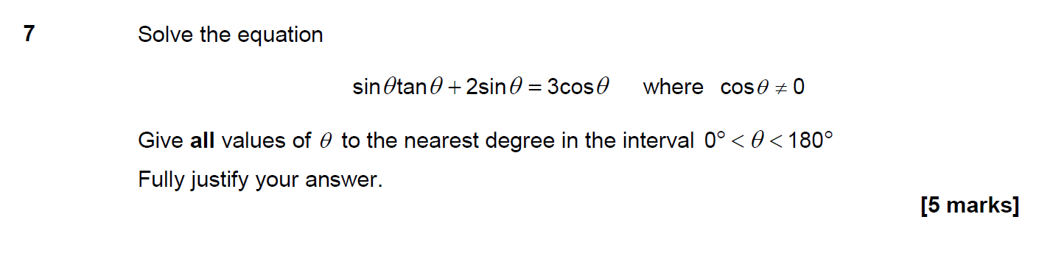

Slide 57
Attributes of Problem solving questions
5. The solution requires understanding of the processes involved, rather than just application of techniques
For examples see Question 9 A-level Maths paper 2 and
Question 8 AS Maths paper 2

Slide 58
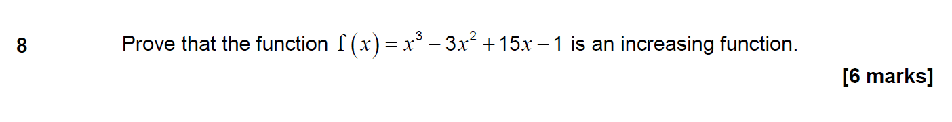

Slide 59
Problem solving and modelling
AO3.3, 3.4 and 3.5 all relate specifically to mathematical modelling
However it with sometimes be the case that unstructured, extended response, problem solving questions will involve the use of mathematical modelling
For example see Question 14 A-level Maths paper 1

Slide 60
Example AO3: Question 15 AS Maths paper 1

Slide 61
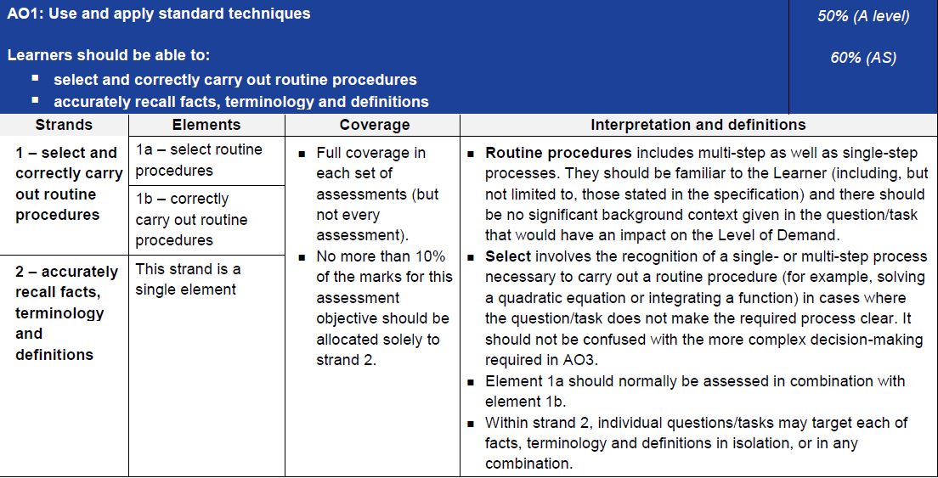
Assessment Objective 1

Slide 62
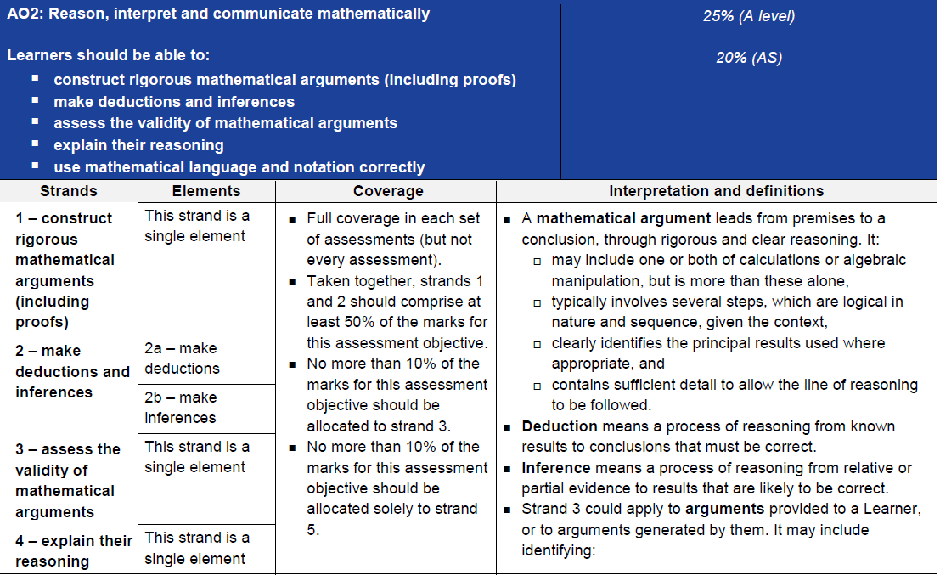
Assessment Objective 2

Slide 63
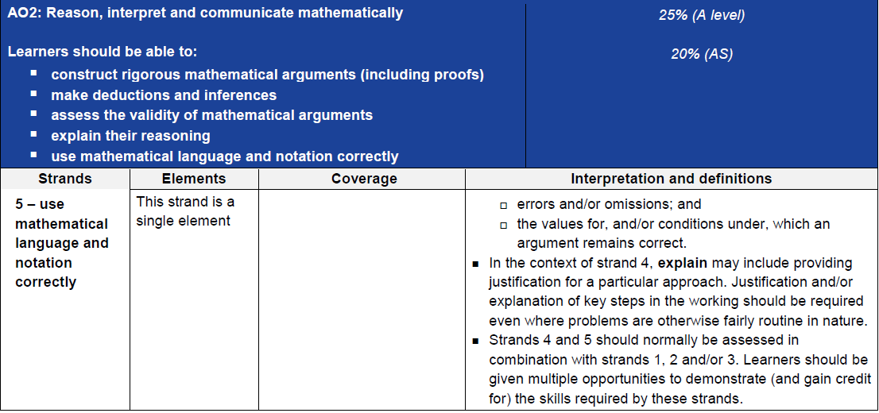
Assessment Objective 2

Slide 64
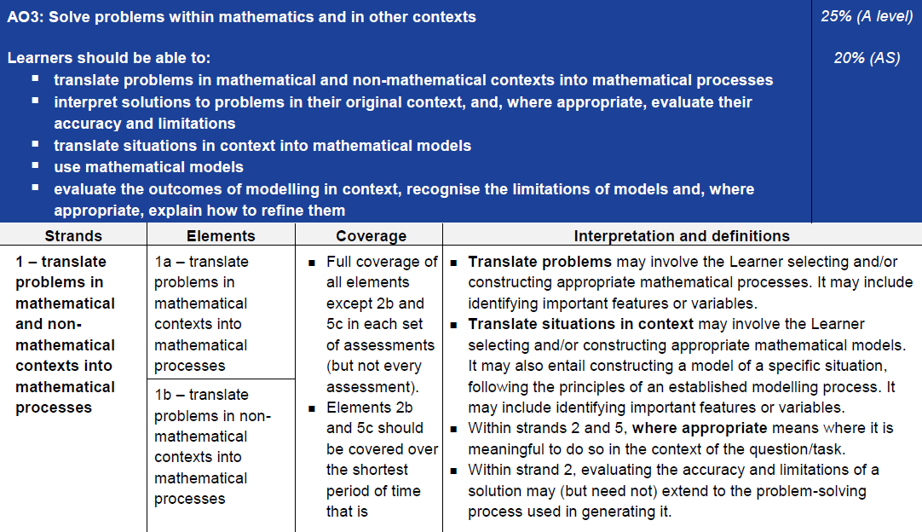
Assessment Objective 3

Slide 65
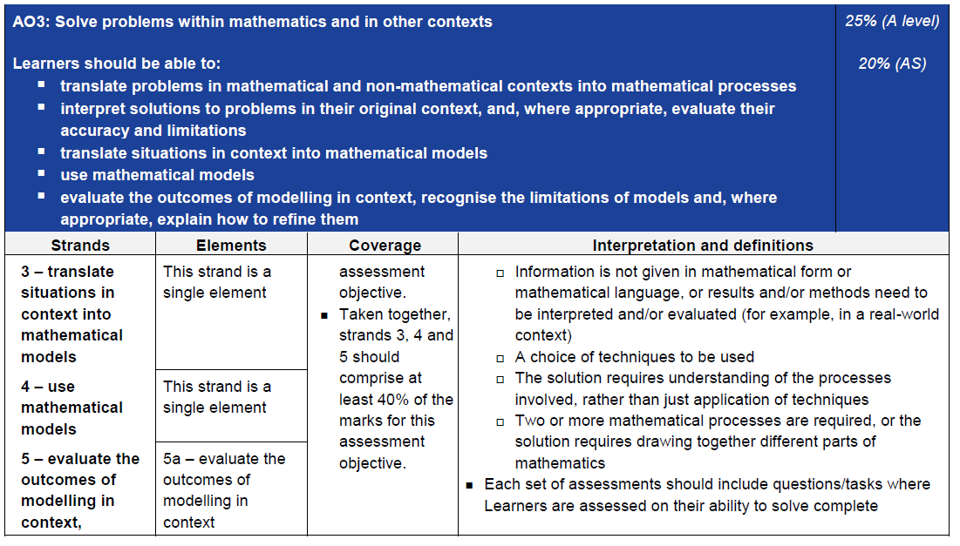
Assessment Objective 3

Slide 66
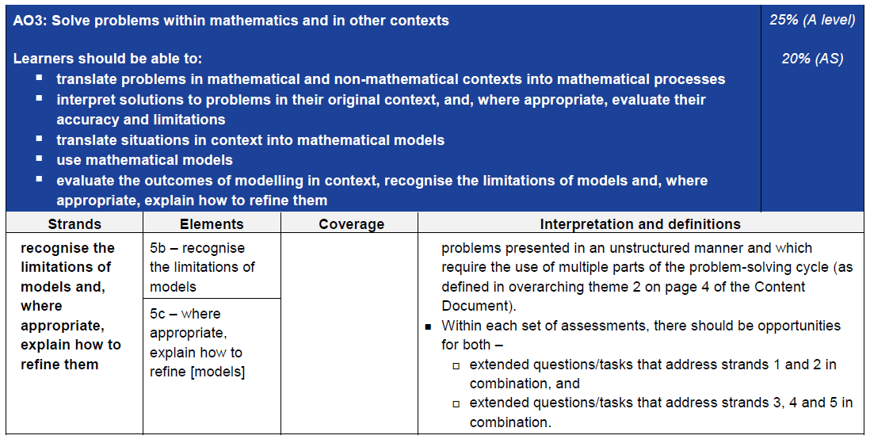
Assessment Objective 3

