Slide 1
Teaching the New Advanced Higher Mathematics Course
Monica Kirson – North Lanarkshire
Saturday 5th September 2015

Slide 2
Advanced Higher Mathematics
Record of Work
Diagnostic Papers for each Unit
Revision Materials for each Unit
3rd Assessment – Unit 1, 2 and 3
Pupil Record Grid – Unit 1, 2 and 3
3 Prelim Papers plus additional bank
Past Papers 2010 to 2014

Slide 3
Advanced Higher Mathematics
Record of Work
Maths in Action Book
TeeJay
Unit 1 – Methods in Algebra & Calculus
Unit 2 – Applications of Algebra & Calculus
Unit 3 – Geometry, Proof & Systems of Equations

Slide 4
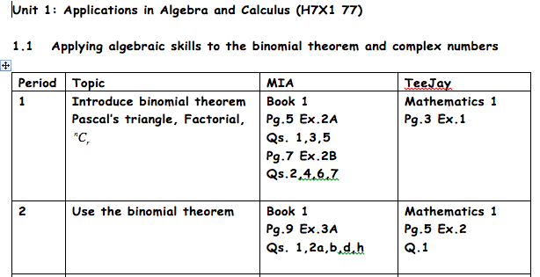
AHMaths – Record of Work

Slide 5
AHMaths – Record of Work

Slide 6
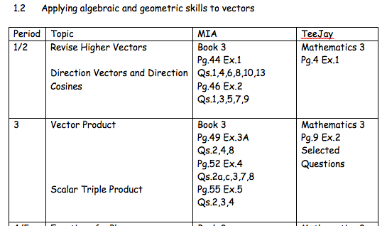
AHMaths – Record of Work

Slide 7
Advanced Higher Mathematics
Diagnostic Papers
Unit 1 – Methods in Algebra & Calculus
Unit 2 – Applications of Algebra & Calculus
Unit 3 – Geometry, Proof & Systems of Equations

Slide 8
AHMaths - Diagnostic Papers

Slide 9
AHMaths - Diagnostic Papers

Slide 10
AHMaths - Diagnostic Papers

Slide 11
Advanced Higher Mathematics
Revision Materials
Unit 1 – Methods in Algebra & Calculus
Unit 2 – Applications of Algebra & Calculus
Unit 3 – Geometry, Proof & Systems of Equations

Slide 12
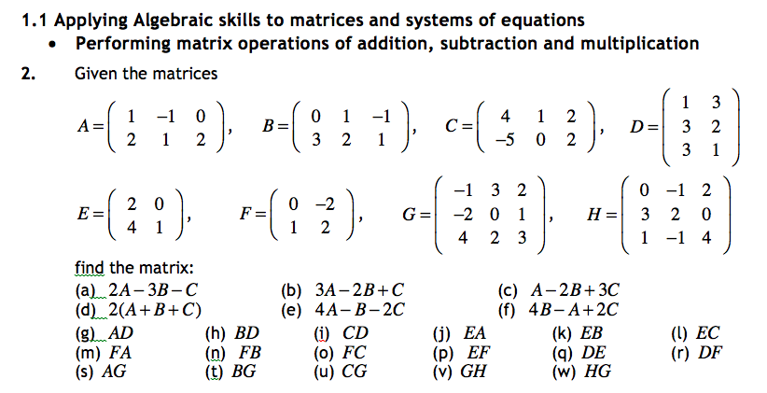
AHMaths – Revision Materials

Slide 13
AHMaths – Revision Materials

Slide 14
AHMaths – Revision Materials

Slide 15
Advanced Higher Mathematics
Unit Assessments - Unit-By-Unit Approach
SQA Pack 1 – 1st Assessment Opportunity
SQA Pack 2 – 2nd Assessment Opportunity
3rd Assessment – 3rd Assessment Opportunity

Slide 16
AHMaths – 3rd Assessment
3rd Assessment – Unit-By-Unit Approach
Unit 1 – Methods in Algebra & Calculus
Unit 2 – Applications of Algebra & Calculus
Unit 3 – Geometry, Proof & Systems of Equations
All 3rd Assessments have been sent to SQA for Prior Verification and will be live for all to use in near future.

Slide 17
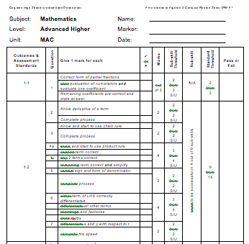
AHMaths – Pupil Record Grids

Slide 18
AHMaths – Prelims
Prelim A – Units 1 and 2
Prelim B – Units 1 and 2 (mostly)
Prelim C – Units 1 and 2 (mostly)
Additional Question Bank – Unit 3

Slide 19
AHMaths – Past Papers 2010 to 2015
Web Based – Wiki Space
Sorted into topics
Full solutions (with commentaries)
Graded according to difficulties within topics

Slide 20
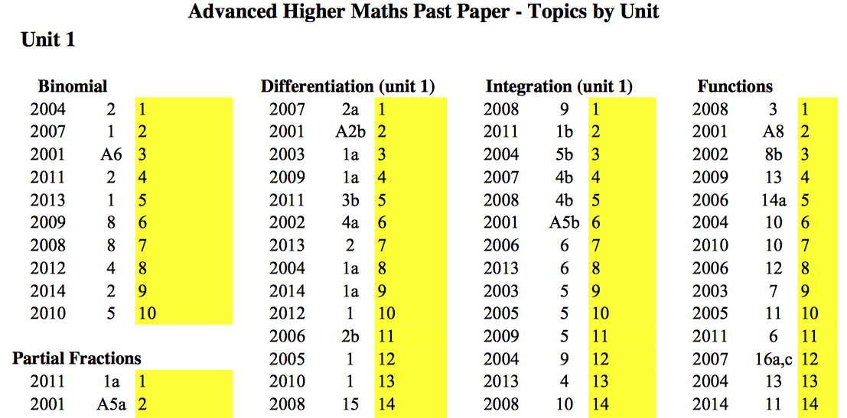
AHMaths – Past Papers 2010 to 2014

Slide 21
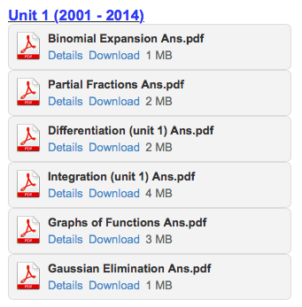
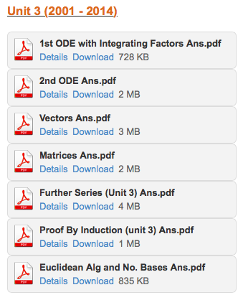
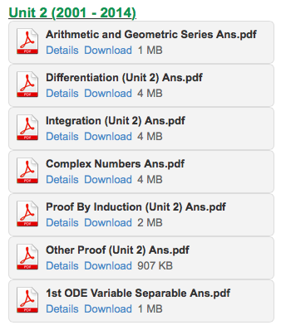
AHMaths – Past Papers 2010 to 2014

Slide 22
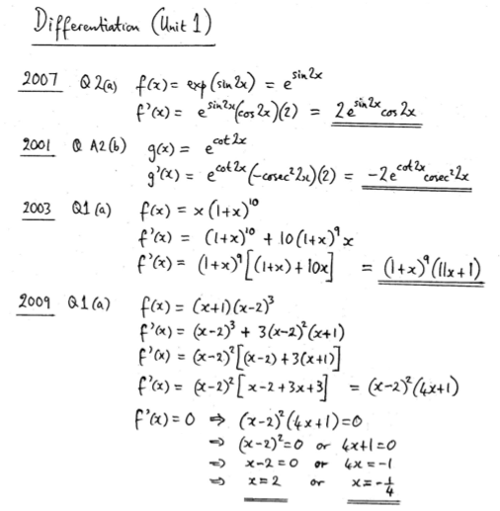
AHMaths
Past Papers
(solutions)

Slide 23
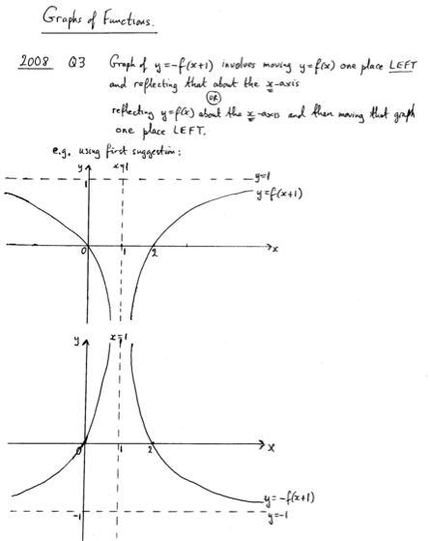
AHMaths
Past Papers
(solutions)

Slide 24
AHMaths – Past Papers 2010 to 2015
Web Based – Wiki Space
http://advmathsnlcslc.wikispaces.com

Slide 25
Thank you for your time and attention
Monica Kirson
kirsonm@ourladys.n-lanark.sch.uk

