Slide 1
KS2 or KS4? Which assessment* do these questions come from?

Slide 2
KS2 or KS4? Which assessment* do these questions come from?
Q1
A
The numbers in this sequence decrease by the same amount each time.
303,704 302,704 301,704 300,704
What is the next term in the sequence?
B
Here are the first 4 terms of a sequence
3 10 17 24
Write down the next term in the sequence
* Numbers tweaked slightly

Slide 3
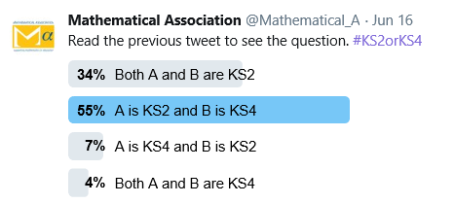
KS2 or KS4? Which assessment* do these questions come from?
Q1
A
The numbers in this sequence decrease by the same amount each time.
303,704 302,704 301,704 300,704
What is the next term in the sequence?
B
Here are the first 4 terms of a sequence
3 10 17 24
Write down the next term in the sequence
KS2
KS4
* Numbers tweaked slightly

Slide 4
KS2 or KS4? Which assessment* do these questions come from?
Q2
Tick the percentage that is closest in value to $\frac{1}{3}$
30%
33%
33.3%
33.4%
Circle two numbers that are equivalent to $\frac{1}{4}$
0.25 0.75 $\frac{25}{100}$ 0.5 $\frac{2}{5}$
A
B
* Questions tweaked slightly

Slide 5
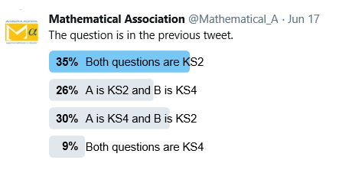
KS2 or KS4? Which assessment* do these questions come from?
Q2
Tick the percentage that is closest in value to $\frac{1}{3}$
30%
33%
33.3%
33.4%
Circle two numbers that are equivalent to $\frac{1}{4}$
0.25 0.75 $\frac{25}{100}$ 0.5 $\frac{2}{5}$
A
B
KS4
KS2
* Questions tweaked slightly

Slide 6
KS2 or KS4? Which assessment* do these questions come from?
Q3
A
B
Work out 15% of 180 g
28% of 850 =
* Questions tweaked slightly

Slide 7
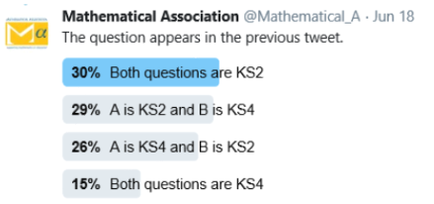
KS2 or KS4? Which assessment* do these questions come from?
Q3
A
B
Work out 15% of 180 g
28% of 850 =
KS4
KS2
* Questions tweaked slightly

Slide 8
KS2 or KS4? Which assessment* do these questions come from?
Q4
Here are four number cards.
David uses each card once to make a
four-digit number. He places:
• 5 in the tens column
• 6 so that it has a higher value than any of the other digits
• the remaining two digits so that 7 has the higher value.
What number did David make?
Here are four digits.
Put one of these digits in each box to give the smallest possible answer to the sum.
Use each digit only once.
A
B
6
3
5
7
7
3
1
6
+
* Questions tweaked slightly

Slide 9
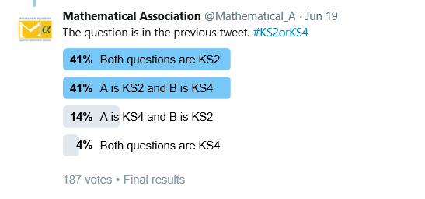
KS2 or KS4? Which assessment* do these questions come from?
Q4
Here are four number cards.
David uses each card once to make a
four-digit number. He places:
• 5 in the tens column
• 6 so that it has a higher value than any of the other digits
• the remaining two digits so that 7 has the higher value.
What number did David make?
Here are four digits.
Put one of these digits in each box to give the smallest possible answer to the sum.
Use each digit only once.
A
B
6
3
5
7
7
3
1
6
+
KS2
KS4
* Questions tweaked slightly

Slide 10
KS2 or KS4? Which assessment* do these questions come from?
Q5
Last year, Mike went to four concerts. Three of his tickets cost £6 each.
The other ticket cost £8
What was the mean cost of the tickets?
Here is a list of numbers:
6 5 2 3 4 5 8 4 2 2
Work out the mean
A
B
* Questions tweaked slightly

Slide 11
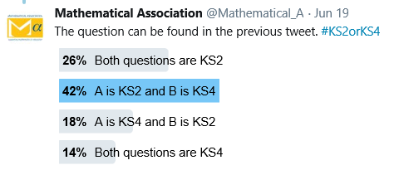
KS2 or KS4? Which assessment* do these questions come from?
Q5
Last year, Mike went to four concerts. Three of his tickets cost £6 each.
The other ticket cost £8
What was the mean cost of the tickets?
Here is a list of numbers:
6 5 2 3 4 5 8 4 2 2
Work out the mean
A
B
KS2
KS4
* Questions tweaked slightly

Slide 12
KS2 or KS4? Which assessment* do these questions come from?
Q6
Tick the numbers that are common factors of both 12 and 18
1
3
4
6
12
What is the highest common factor of 18 and 54?
A
B
* Questions tweaked slightly

Slide 13
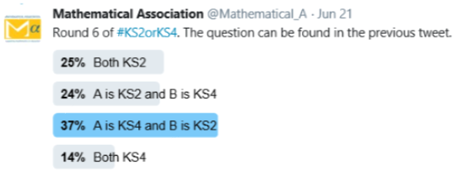
KS2 or KS4? Which assessment* do these questions come from?
Q6
Tick the numbers that are common factors of both 12 and 18
1
3
4
6
12
What is the highest common factor of 18 and 54?
A
B
KS2
KS4
* Questions tweaked slightly

Slide 14
KS2 or KS4? Which assessment* do these questions come from?
Q7
Susan has a bag containing red and green grapes
$\frac{4}{9}$ of the grapes are green.
If there are 8 green grapes in the bag, how many grapes are red?
Shade $\frac{3}{5}$ of the grid
A
B
* Questions tweaked slightly

Slide 15
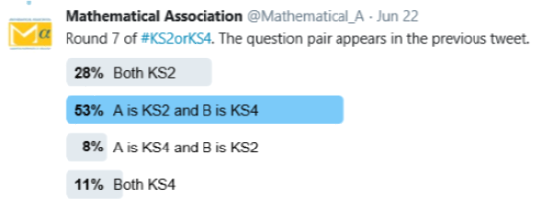
KS2 or KS4? Which assessment* do these questions come from?
Q7
Susan has a bag containing red and green grapes
$\frac{4}{9}$ of the grapes are green.
If there are 8 green grapes in the bag, how many grapes are red?
Shade $\frac{3}{5}$ of the grid
A
B
KS4
KS4
* Questions tweaked slightly

Slide 16
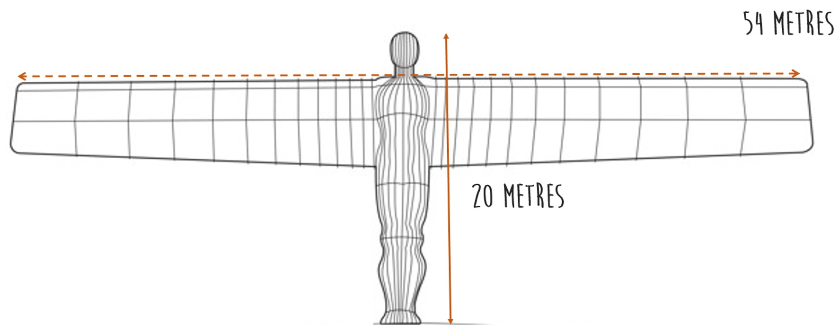
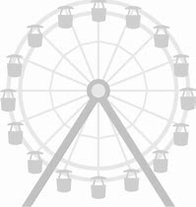
KS2 or KS4? Which assessment* do these questions come from?
Q8
The Angel of the North is a large statue in England. It is 20 metres tall and 54 metres wide.
Alison makes a scale model of the Angel of the North. Her model is 108 centimetres wide.
How tall is her model?
Here is a scale drawing.
The Ferris wheel has a height of 140m.
Work out the height of the building.
A
B
Not to scale
* Questions tweaked slightly

Slide 17
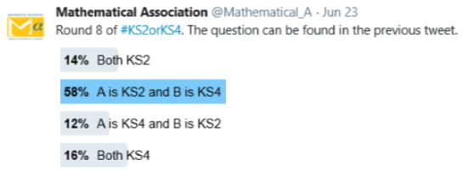
KS2 or KS4? Which assessment* do these questions come from?
Q8
The Angel of the North is a large statue in England. It is 20 metres tall and 54 metres wide.
Alison makes a scale model of the Angel of the North. Her model is 108 centimetres wide.
How tall is her model?
Here is a scale drawing.
The Ferris wheel has a height of 140m.
Work out the height of the building.
A
B
Not to scale
KS2
KS4
* Questions tweaked slightly

Slide 18
KS2 or KS4? Which assessment* do these questions come from?
Q9
A piece of wire is 260 cm long.
Simon cuts two 45 cm lengths off the wire.
He then cuts the rest of the wire into as many 40 cm lengths as possible.
Work out how many 40 cm lengths of wire Simon cuts.
There are 28 pupils in a class.
The teacher has 7 litres of orange juice.
She pours 225 millilitres of orange juice for every pupil.
How much orange juice is left over?
A
B
* Questions tweaked slightly

Slide 19
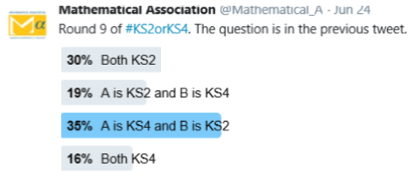
KS2 or KS4? Which assessment* do these questions come from?
Q9
A piece of wire is 260 cm long.
Simon cuts two 45 cm lengths off the wire.
He then cuts the rest of the wire into as many 40 cm lengths as possible.
Work out how many 40 cm lengths of wire Simon cuts.
There are 28 pupils in a class.
The teacher has 7 litres of orange juice.
She pours 225 millilitres of orange juice for every pupil.
How much orange juice is left over?
A
B
KS4
KS2
* Questions tweaked slightly

Slide 20
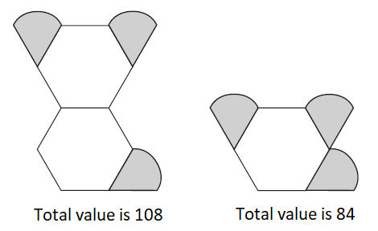
KS2 or KS4? Which assessment* do these questions come from?
Q10
Emma is making designs with two different shapes. She gives each shape a value.
Calculate the value of each shape.
Circle the improper fraction that is equivalent to $7\frac{5}{8}$
$\frac{75}{8}$ $\frac{56}{8}$ $\frac{43}{8}$ $\frac{61}{8}$ $\frac{57}{8}$
A
B
* Questions tweaked slightly

Slide 21
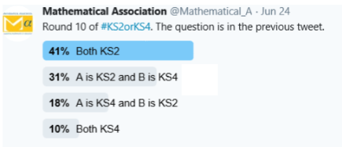
KS2 or KS4? Which assessment* do these questions come from?
Q10
Emma is making designs with two different shapes. She gives each shape a value.
Calculate the value of each shape.
Circle the improper fraction that is equivalent to $7\frac{5}{8}$
$\frac{75}{8}$ $\frac{56}{8}$ $\frac{43}{8}$ $\frac{61}{8}$ $\frac{57}{8}$
A
B
KS2
KS2
* Questions tweaked slightly

