Slide 1
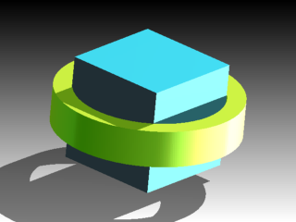
Further Adventures in the Teaching of Area
Dr Chris Pritchard
Mathematical Association Secretary
Mathematical Association Annual Conference,
Royal Holloway, April 2017,

Slide 2
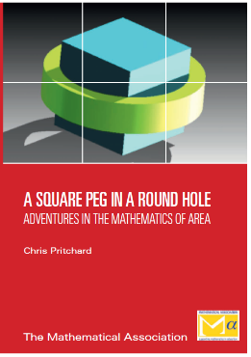
A Square Peg in a Round Hole and Archimedes’ Elephant
Archimedes’ Elephant
Further Adventures in the Mathematics of Area
To be published in Autumn 2018

Slide 3
Overview
1. Pick’s Theorem
2. Algebra
3. Paths and frames
4. Curve stitching
5. Tethered goats
6. Sangaku
7. Sport and area

Slide 4
Pick’s Theorem
Georg Alexander Pick (1859-1942) showed in 1899 that if a polygon has its vertices at points on a square grid, then there is a formula for the area, A, in terms of the number of boundary points, b, and interior points, i.

Slide 5
Pick’s Theorem: No Interior Points
Shape | C | H | F | B | E | D | G | I
b | 3 | 4 | 5 | 6 | 7 | 8 | 9 | 10
A | $$\frac{1}{2}$$ | $$\frac{2}{2}$$ | $$\frac{3}{2}$$ | $$\frac{4}{2}$$ | $$\frac{5}{2}$$ | $$\frac{6}{2}$$ | $$\frac{7}{2}$$ | $$\frac{8}{2}$$
$A=\frac{1}{2}\left(b−2\right)$
$$A=\frac{1}{2}b−1$$
$$A+1=\frac{b}{2}$$

Slide 6
Pick’s Theorem: 1 interior Point
 | L | K | P | J | M | N | Q | R
b | 3 | 4 | 5 | 6 | 7 | 8 | 9 | 10
A | 1½ | 2 | 2½ | 3 | 3½ | 4 | 4½ | 5
A + 1 | $$\frac{5}{2}$$ | $$\frac{6}{2}$$ | $$\frac{7}{2}$$ | $$\frac{8}{2}$$ | $$\frac{9}{2}$$ | $$\frac{10}{2}$$ | $$\frac{11}{2}$$ | $$\frac{12}{2}$$
$$A+1=\frac{b}{2}+1$$

Slide 7
Pick’s Theorem: 2 Interior Points
 | U | V | Y | T | W | X | Z | S
b | 3 | 4 | 5 | 6 | 7 | 8 | 9 | 10
A | 2½ | 3 | 3½ | 4 | 4½ | 5 | 5½ | 6
A + 1 | $$\frac{7}{2}$$ | $$\frac{8}{2}$$ | $$\frac{9}{2}$$ | $$\frac{10}{2}$$ | $$\frac{11}{2}$$ | $$\frac{12}{2}$$ | $$\frac{13}{2}$$ | $$\frac{14}{2}$$
$$A+1=\frac{b}{2}+2$$

Slide 8
Pick’s Theorem: Towards a Formula
For $i=0, A+1=\frac{b}{2}+0$;
for $i=1, A+1=\frac{b}{2}+1$;
for $i=2, A+1=\frac{b}{2}+2$.
$$A+1=\frac{b}{2}+i$$
$$Standard result A=\frac{b}{2}+i−1$$

Slide 9
Pick’s Theorem: Testing
$$A=\frac{b}{2}+i−1$$
$$=\frac{10}{2}+7−1=11$$

Slide 10

Factorising Difference of Squares
$$x^{2}−y^{2}=\frac{1}{2}\left(2x+2y\right)\left(x−y\right)=\left(x+y\right)\left(x−y\right).$$

Slide 11

Factorising Difference of Cubes
$$x^{3}−y^{3}=\left(x−y\right)\left(x^{2}+xy+y^{2}\right)$$

Slide 12
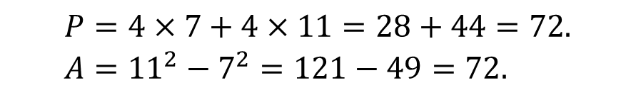
Paths & Frames 1
Calculate A, the area of the path, if the lawn is square and the width of the path is 2 m.
Now calculate P, the total perimeter of the path, which is the sum of the blue and red line segments.
$$P=4×7+4×11=28+44=72.$$
$$A={11}^{2}−7^{2}=121−49=72.$$

Slide 13

Paths & Frames 2
Calculate the total perimeter and the area of the path around the swimming pool if its width is also 2 m.
$$P=2\left(29+10\right)+2\left(25+6\right)=140.$$
$$A=29×10−25×6=290−150=140.$$

Slide 14
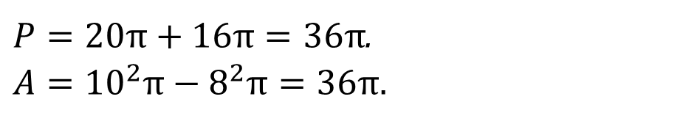
Paths & Frames 3
Calculate the total perimeter and the area of the path around the boating pond if its width is also 2 m.
$P=20π+16π=36π$.
$$A={10}^{2}π−8^{2}π=36π.$$

Slide 15
Paths & Frames 4
Starting positions for proofs that numerical equality occurs when the path or frame has width 2 units.

Slide 16
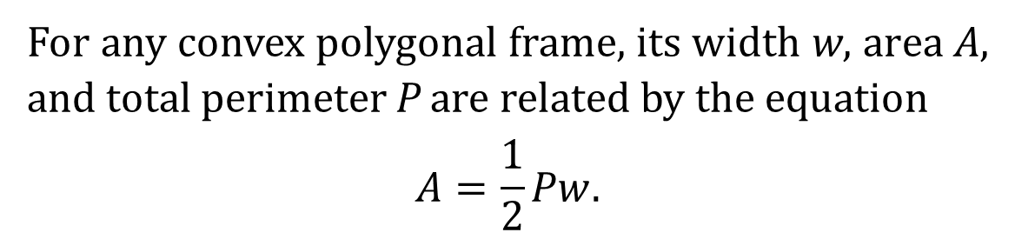

Paths & Frames 5
The general result (Tom Apostol & Mamikon Mnatsakanian)
For any convex polygonal frame, its width w, area A, and total perimeter P are related by the equation
$$A=\frac{1}{2}Pw.$$
Note that A = P if w = 2.
$A=P=2π\left(r+1\right)+4\left(r+2\right)$

Slide 17
Boolean Stitching 1
Mary Boole, wife of George Boole, used the idea of curve stitching in her teaching of mathematics in the second half of the nineteenth century.
What are the areas of the kite and triangles in each figure?

Slide 18
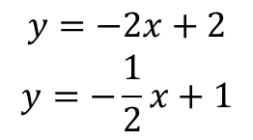
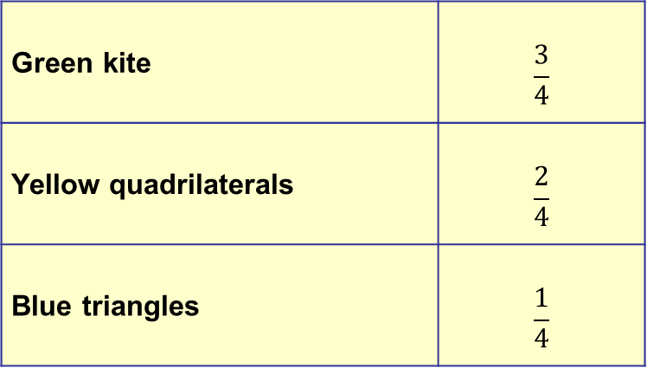
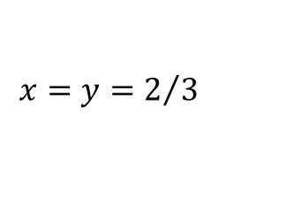
Boolean Stitching 2
$$\begin{matrix}y=−2x+2 \\ y=−\frac{1}{2}x+1\end{matrix}$$
$$x=y=2/3$$
Task: work out the areas in the 3-string case.
Green kite | $$\frac{3}{4}$$
Yellow quadrilaterals | $$\frac{2}{4}$$
Blue triangles | $$\frac{1}{4}$$

Slide 19
Tethered Goat
Problem
A goat is tethered by a 10 m rope to the outside of a building which is 5 m square so that he can graze to his stomach’s content on the pasture surrounding it.
What is the area of the pasture he can graze?

Slide 20
Tethered Goat
$$A=\frac{1}{2}π.{10}^{2}+\frac{1}{4}π\left[{\left(10−x\right)}^{2}+{\left(5+x\right)}^{2}+{\left(5−x\right)}^{2}+x^{2}\right]$$
$$A=\frac{π}{2}\left(2x^{2}−10x+175\right)$$

Slide 21
Tethered Goat
max area of 175π/2 when $x=0$
min area of 325π/4 when $x=\frac{5}{2}$

Slide 22
Sangaku
In 1603, there was a major royal event:
Elizabeth 1 died and the Tudors were replaced by the Stuarts in the form of James I.
Alternatively, in 1603, there was a major royal event:
Ieyasu, the first of the Tokugawa shoguns, grabbed power and thus began the Edo (‘Yedo’) Period in Japan.
Ieyasu effectively cut off his country from most of the rest of the world.
Japanese scholars responded by posing problems (mainly geometrical problems) on wooden tablets or sangaku and hanging them in Buddhist temples and Shinto shrines for others to solve.

Slide 23
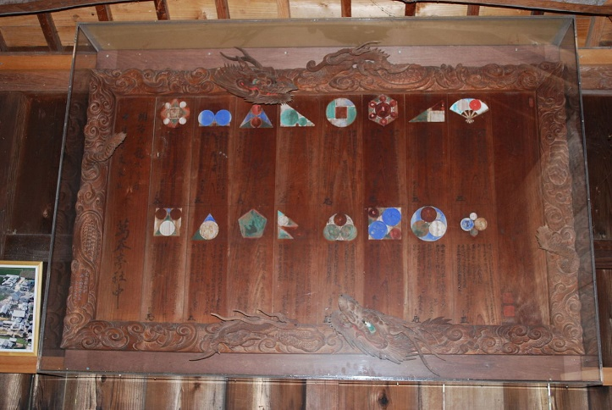
Sangaku
Katayamahiko Shrine in the city of Okayama in western Honshū (1873)

Slide 24
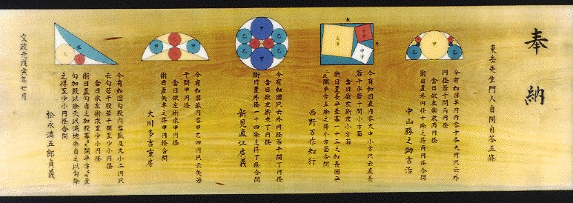
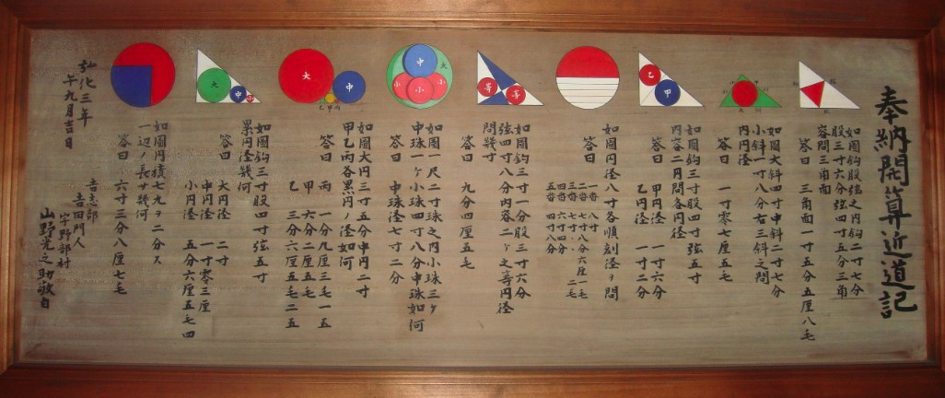
More Sangaku

Slide 25
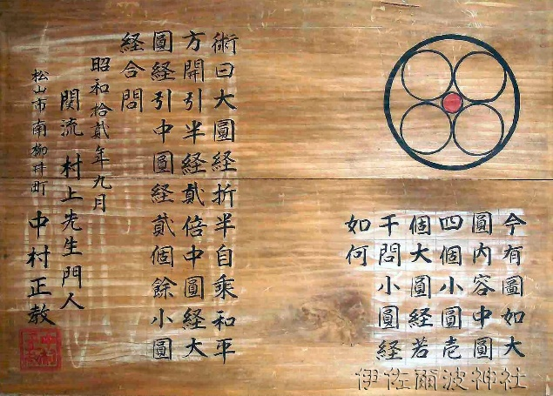
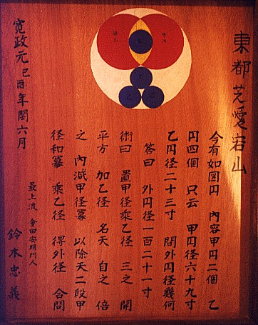
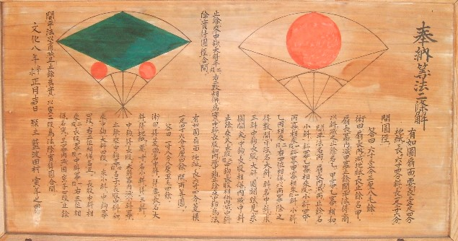

Slide 26
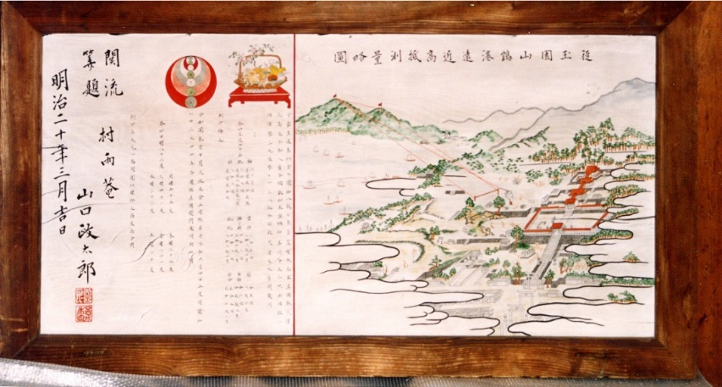

Slide 27
Sāto’s Sangaku
This sangaku was hung in the Akahagi Kannon temple in Ichinosecki by a 13-year old boy, Sāto Naosue in 1847. It asks for the relative sizes of the green and blue circles.

Slide 28
Sāto’s Sangaku
Hint 1 : let the red circles have unit radius and try to find the radius of a green circle.
Hint 2 : join the centres of a red and green circle and use Pythagoras’ Theorem.

Slide 29
Sāto’s Sangaku
$${ \left(r+1\right)}^{2}={\left(2−r\right)}^{2}+1^{2}$$
$${⇒ r}^{2}+2r+1=4−4r+r^{2}+1$$
$$⇒ 6r=4$$
$$⇒ r=\frac{2}{3} .$$

Slide 30
Sāto’s Sangaku
Now focus of triangle EDC:
$${ \left(x+3\right)}^{2}={\left(x+1\right)}^{2}+4^{2}$$
$${⇒ x}^{2}+6x+9=x^{2}+2x+1+16$$
$$⇒ 4x=8$$
$$⇒ x=2.$$
So CD = 3 and by the properties of similar triangles, R = 4/3 and R = 2r.

Slide 31
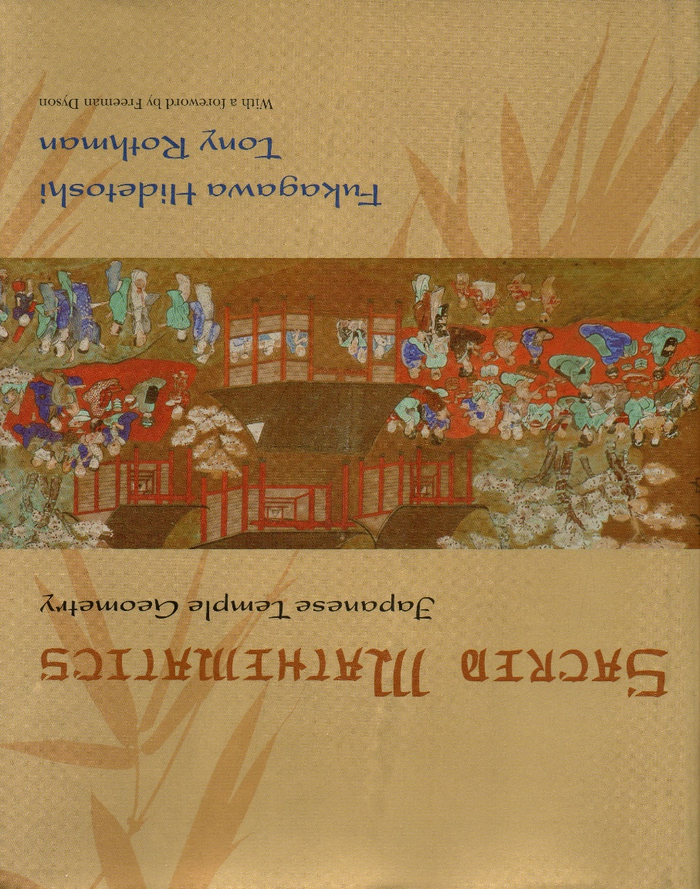
Reference for Sangaku
Sacred Mathematics: Japanese Temple Geometry, by Fukagawa Hidetoshi & Tony Rothman, Princeton University Press, 2008.
For images of sangaku simply search for ‘Sangaku Images’ in Google Images.

Slide 32
Sports Tracks, Pitches & Fields

Slide 33
Further Adventures in the Teaching of Area
Dr Chris Pritchard
Mathematical Association Secretary
Contact: chrispritchard2@aol.com

